Slide 1
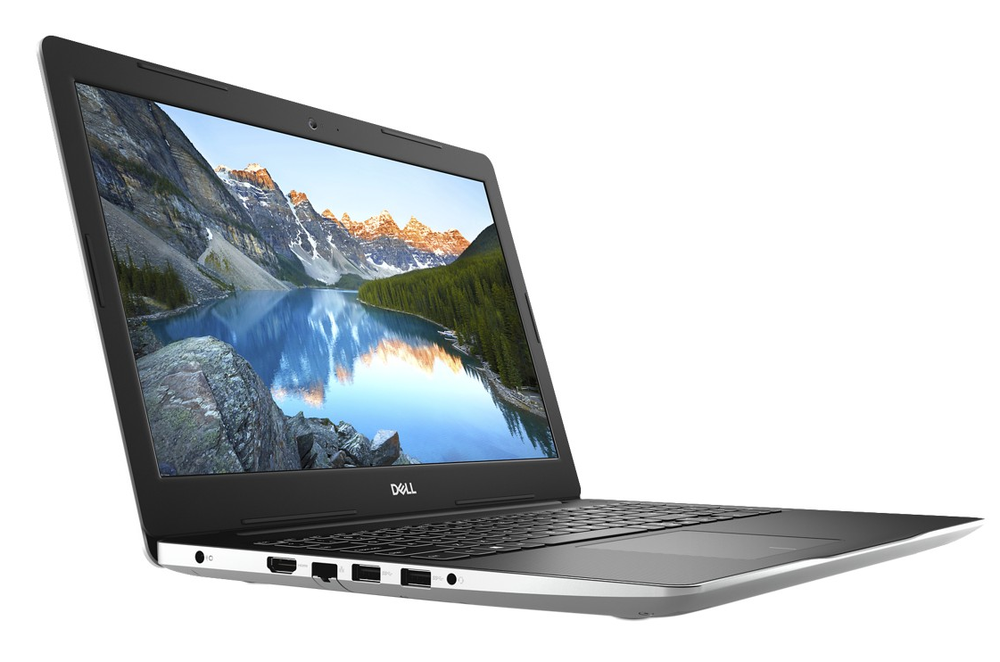
Dell recommends Windows®
AD# TBD
Under NDA until January 7, 2019
Dell Inspiron 14/15/17 3000 (Intel®) Laptop
Models 348x, 358x, 378x
Reviewer’s Guide – December 2018
Product appearance may vary slightly from image shown.
Notes:
Revised April 18, 2017

Slide 2
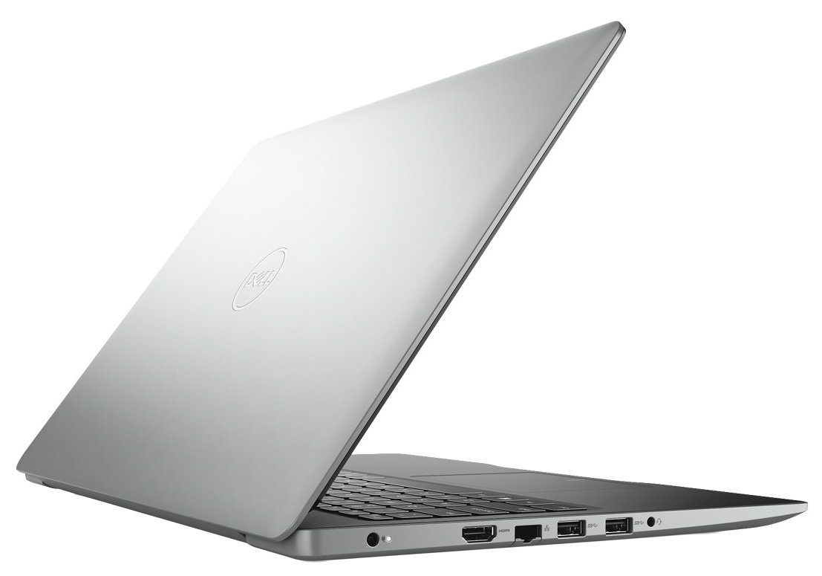
Table of contents
Inspiron Brand 3
Feature Overview 4-6
Inspiron Essential Accessories 7-8
Product Technical Specs 9-19
Product Gallery 20-35
Battery Life & Weight Claims 36-39
Inspiron Software 40
Services 41
Important Information 42
Product appearance may vary slightly from image shown.

Slide 3
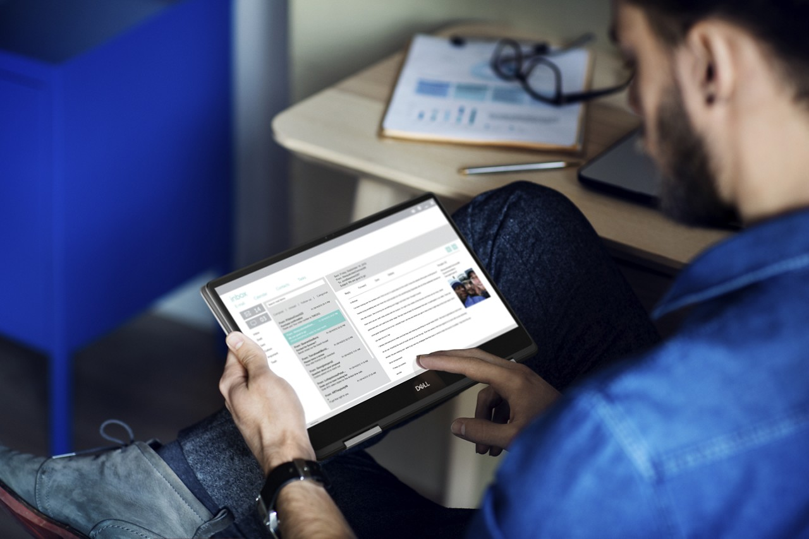
Inspiron brand
Inspiron laptops and 2-in-1s are easy to use, easy to own, and keep you connected to everything that matter to you. They are designed to deliver exceptional value for today’s consumers looking to get more out of life.
Easy – Regardless of price, consumers want a product that is easy to set up and ready to use once it is out of the box. They want to create and share content between devices regardless of operating system or form factor with ease. Dell products are designed to make that happen with the latest technology, a range of hard drive storage and memory options, sharp high resolution displays that can be viewed at any angle, firm keyboards that are easy to type on for hours and a complete audio solution that includes headphones, external speakers, and unique software options.
Meaningful Innovation – Dell strives to help its customers interact with what matters most to them. Innovative technologies help people to get more out of life, and should meet the needs of today and tomorrow. Lags, delays and buffering become a thing of the past. The latest processors and graphics zip through video edits. Brilliant displays provide crisp, honest representation of your content. Specially tuned audio provides immersive sound. Wireless connects quickly and stays connected. Purposeful innovation makes all of this more fun, especially when it’s so seamless.
Product appearance may vary slightly from image shown.

Slide 4
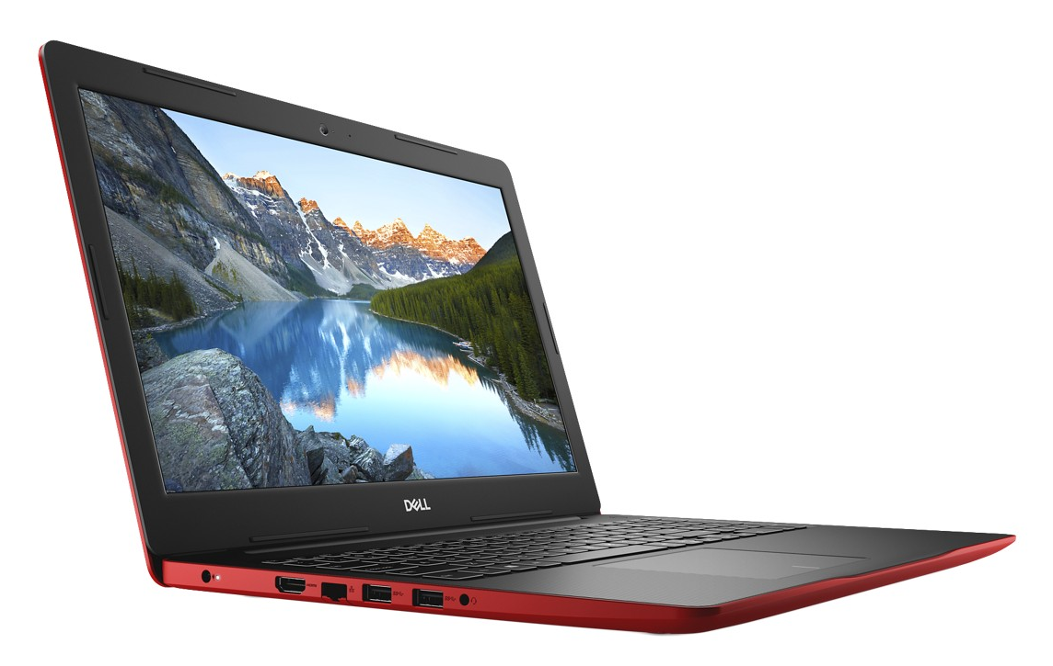
Inspiron 14/15/17 3000 Feature Overview
Your daily must-have
MAKE THE MOST OF EVERY DAY
Featuring Intel® processors and an array of ports, the new Inspiron 14”, 15”, & 17” 3000 laptops meet all of your everyday computing needs and look good doing it. The 14” & 15” offer a portable design that is easy to carry with you everywhere, and the 17” is made for the entire family to use throughout the home. Enjoy style for miles with a variety of fun color options (based on regional availability).
Dell Cinema - The ultimate personal theater experience
Dell’s CinemaStream, powered by SmartByte, delivers a virtually lag-free video streaming experience with this connection optimizer solution which prioritizes video streaming ahead of other network traffic for uninterrupted entertainment.
With CinemaColor, visuals appear every bit as lifelike as the world around you. Experience richer, more vibrant color and details enabled by Dell Color Profiles.
Dell’s CinemaSound suite of enhancements include speakers that are professionally tuned by audio engineers and Waves MaxxAudio® Pro software for the best audio experience possible.
Product appearance may vary slightly from image shown.

Slide 5
Inspiron 14/15/17 3000 Feature Overview
Your daily must-have
Flexible to fit your needs
From subdued to stand-out, choose the exterior color option that best reflects you. Black and Platinum Silver are available on all sizes while the 15” & 17” also offer Sparkling White, Beijing Red, Ultra Blue, Copper, and Orchid Bloom (based on regional availability). All color options come with a sleek black interior.
Customize your experience and enjoy fast, reliable performance with up to 8th Generation Intel® CoreTM i7 processors; up to 20GB of DDR4 memory; and a variety of storage options including up to 2TB hard drives, up to 256GB PCIe solid state drives, and dual drive options.
Choose from a variety of display options. On the 14”, an HD non-touch display and FHD non-touch display with IPS technology provide clear and crisp images. On the 15”, chose between HD and FHD displays, and select a touch option for added interactivity with onscreen content. On the 17”, the HD+ panel comes in both non-touch and touch options while an FHD IPS display allows you to view the screen from a wide variety of angles.
Boost your graphical performance with optional discrete graphics, up to AMD Radeon™ 520 Graphics with 2GB GDDR5 graphics memory.
Supports optional Intel® OptaneTM Memory which boosts the responsiveness of a HDD-based system by memorizing frequently used commands for a faster, smoother, experience.
Enjoy an array of ports. Connect to a TV or monitor with the HDMI port, download photos via the SD card slot, and enjoy fast transfer speeds from all your accessories with two USB 3.1 Gen 1 ports. The RJ45 port (not available on Model #s 3482, 3582, & 3782) gives you the flexibility to use a wired connection.
Budgeting and other calculations are a snap on the 15” & 17” with the numeric keypad.
An optical drive is standard on the 17” and allows you to easily play DVDs or archive large files. On the 15”, the optical drive comes standard on Model #s 3580 & 3581 and is optional on Model #3582.
Featuring Windows 10 - the best ever Windows features are available right out of the box. With an optional fingerprint reader on the power button and Windows Hello, sign-on is easy, fast and safe.
Easily type under dim light, such as when you’re working on the plane during an evening flight or when you need to access your device in bed with an optional backlit keyboard.
With Dell Mobile Connect software, experience seamless PC/smartphone integration. Interact directly on the screen with the phone while it stays in pockets and purses.
Product appearance may vary slightly from image shown.

Slide 6
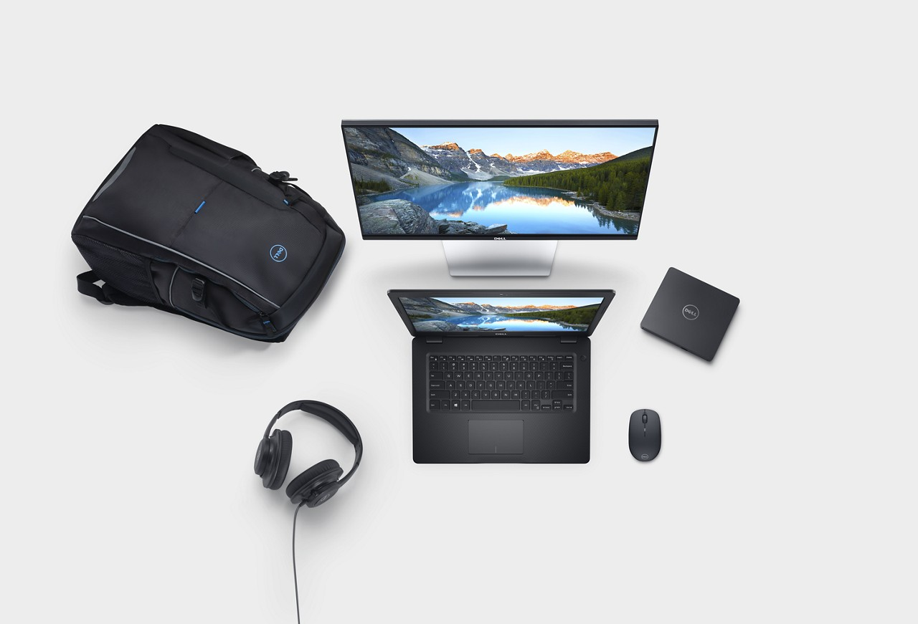
Optional Inspiron accessories 14
You can maximize the versatility and performance of your Inspiron 14 3000 with Dell recommended accessories to keep you entertained and connected in any room.
Dell 23 Monitor – S2319H
Complement your desk with this elegant and stylish 23-inch monitor designed to shine with ultra bezels and built-in dual 3W speakers.
Dell Wireless Mouse – WM126
Travel light with a compact, wireless mouse with optical tracking and long battery life.
Dell Performance USB Headset – AE2
Experience a 360 immersive soundscape and engage in hours of gameplay in a comfortable, lightweight headset with breathable, soft leather ear pads. The omni-directional microphone lets you stay connected with your friends.
Dell External USB Slim DVD +/-RW Optical Drive – DW316
Plug this low profile, lightweight drive into your Inspiron laptop’s USB port and you’ll be ready to play your favorite games or DVDs or back up your files.
Dell Urban 2.0 Backpack 15
Stow and go in style with this versatile and lightweight backpack that fits up to a 15.6” laptop. Comes with plenty of pockets, secure laptop compartment and large storage area to help you stay organized.
Product appearance may vary slightly from image shown.
Optional accessories shown subject to regional availability.

Slide 7
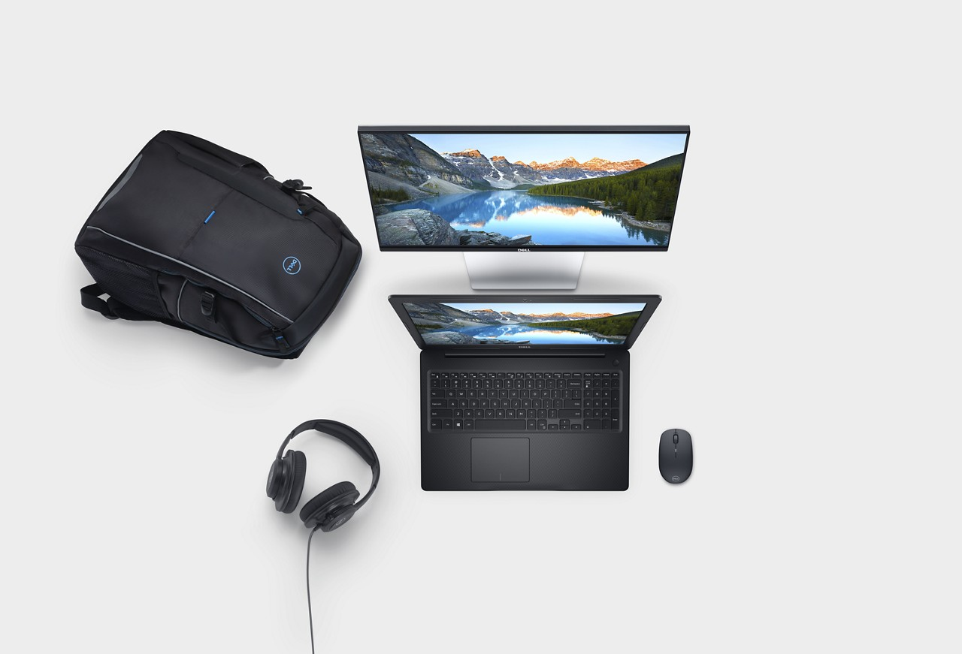
Optional Inspiron accessories 15
You can maximize the versatility and performance of your Inspiron 15 3000 with Dell recommended accessories to keep you entertained and connected in any room.
Dell 23 Monitor – S2319H
Complement your desk with this elegant and stylish 23-inch monitor designed to shine with ultra bezels and built-in dual 3W speakers.
Dell Wireless Mouse – WM126
Travel light with a compact, wireless mouse with optical tracking and long battery life.
Dell Performance USB Headset – AE2
Experience a 360 immersive soundscape and engage in hours of gameplay in a comfortable, lightweight headset with breathable, soft leather ear pads. The omni-directional microphone lets you stay connected with your friends.
Dell Urban 2.0 Backpack 15
Stow and go in style with this versatile and lightweight backpack that fits up to a 15.6” laptop. Comes with plenty of pockets, secure laptop compartment and large storage area to help you stay organized.
Product appearance may vary slightly from image shown.
Optional accessories shown subject to regional availability.

Slide 8
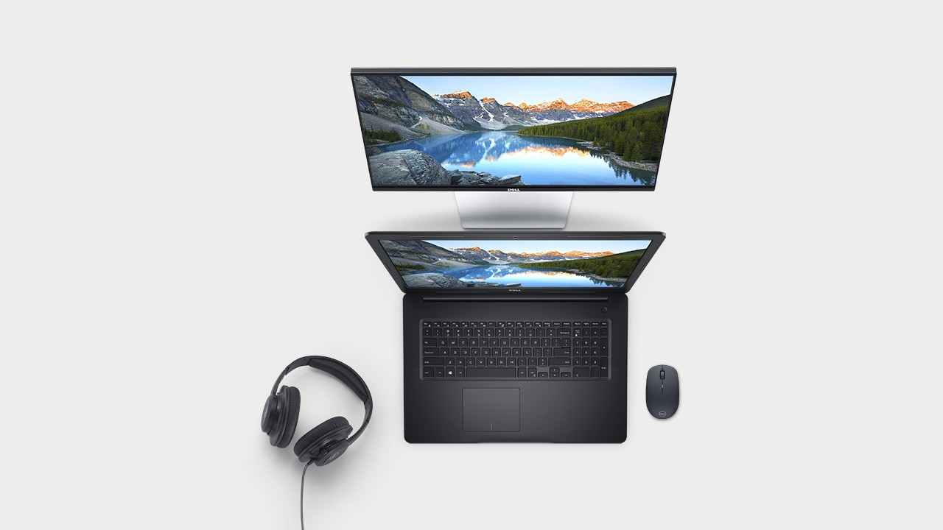
Optional Inspiron accessories 17
You can maximize the versatility and performance of your Inspiron 17 3000 with Dell recommended accessories to keep you entertained and connected in any room.
Dell 23 Monitor – S2319H
Complement your desk with this elegant and stylish 23-inch monitor designed to shine with ultra bezels and built-in dual 3W speakers.
Dell Wireless Mouse – WM126
Travel light with a compact, wireless mouse with optical tracking and long battery life.
Dell Performance USB Headset – AE2
Experience a 360 immersive soundscape and engage in hours of gameplay in a comfortable, lightweight headset with breathable, soft leather ear pads. The omni-directional microphone lets you stay connected with your friends.
Product appearance may vary slightly from image shown.
Optional accessories shown subject to regional availability.

Slide 9
Inspiron 14 3000 (3480)
Features & Technical Specifications
Feature | Technical Specification
Model Number | Model# 3480
Processor Options | 8th Generation Intel® Core™ i3-8145U Processor (4MB Cache, up to 3.9 GHz) 8th Generation Intel® Core™ i5-8265U Processor (6MB Cache, up to 3.9 GHz) 8th Generation Intel® Core™ i7-8565U Processor (8MB Cache, up to 4.6 GHz)
Operating System* | Windows® 10 Ubuntu
Graphics | Intel® UHD Graphics 620 with shared graphics memory AMD Radeon™ 520 Graphics with 2G GDDR5 graphics memory
Display | 14.0-inch HD (1366 x 768) Anti-Glare LED-Backlit Non-touch Display 14.0-inch FHD (1920 x 1080) Anti-Glare LED Backlit Non-touch IPS Display
Memory Options* | 4GB, 4Gx1, DDR4, 2400MHz 8GB, 4Gx2, DDR4, 2400MHz 8GB, 8Gx1, DDR4, 2400MHz 12GB, 8Gx1 + 4Gx1, DDR4, 2400MHz 16GB, 8Gx2, DDR4, 2400MHz 16GB, 16Gx1, DDR4, 2400MHz 20GB Memory: 4GB, 4Gx1, DDR4 2400MHz DRAM + 16GB Intel® Optane™ Memory 24GB Memory: 8GB, 8Gx1, DDR4 2400MHz DRAM + 16GB Intel® Optane™ Memory 32GB Memory: 16GB, 16Gx1, DDR4 2400MHz DRAM + 16GB Intel® Optane™ Memory
Storage Options* | 500GB/1T/2T 5400 rpm 2.5" SATA Hard Drive 500GB/1T 7200 rpm 2.5" SATA Hard Drive 128GB/256GB m.2 PCIe Solid State Drive Dual drive config with up to 2TB 5400 rpm Hard Drive + up to 256GB SSD
Ports, Slots & Chassis | USB 3.1 Gen 1 (x2), USB2.0 (x1), HDMI 1.4b SD Media Card Reader (SD, SDHC, SDXC) RJ45 - 10/100Mbps
Input | Optional backlit, Standard full size spill-resistant keyboard Multi-touch gesture-enabled precision touchpad with integrated scrolling
Optical Drive Options | No Optical Drive
Feature | Technical Specification
Multimedia | 2 tuned speakers with Waves MaxxAudio® Pro 1 combo headphone / microphone jack Integrated widescreen HD (720p) Webcam with Single Digital Microphone
Connectivity Options | 802.11bgn 1x1 WiFi & BT 4.0 802.11ac 1x1 WiFi & BT 4.1 802.11ac 2x2 WiFi & BT 4.1 802.11ac 2x2 WiFi & BT 5.0 802.11ac 1x1 WiFi & BT 5.0
Battery Options* | 3-Cell 42WHr Battery (Integrated)
AC Adapter | 45 Watt AC Adaptor 65 Watt AC Adaptor
Dimensions & Weight* | H/W/D: 19.9 – 21.0 x 339.0 x 241.9 mm / 0.78” – 0.83” x 13.35” x 9.52” Starting Weight:
Color | Black, Platinum Silver
Security | FingerPrint Reader with Windows Hello (Optional) Wedge-shaped lock slot
Software | SmartByte Network Optimization Solution, Dell Digital Delivery, Dell Recovery Environment, Support Assist, My Dell, DropBox, Microsoft® Office 2016 trial, McAfee LiveSafe (30Day), Dell Mobile Connect
Peripheral Ecosystem | Dell 23 Monitor – S2319H Dell Urban 2.0 Backpack 15 Dell Wireless Mouse WM126 Dell External USB Slim DVD+/=RW Optical Drive DW316 Dell Performance USB Headset AE2 Dell Universal Dock- D6000 Dell Docking Station – USB 3.0 (D3100)
Regulatory and Environmental Compliance | ENERGY STAR 7.1
NOTES:
Hard Drives: GB means 1 billion bytes and TB equals 1 trillion bytes; actual capacity varies with preloaded material and operating environment and will be less.
Graphics & System Memory: GB means 1 billion bytes and TB equals 1 trillion bytes; significant system memory may be used to support graphics,
depending on system memory size and other factors.
Battery life figures are based on testing using the Mobile Mark 2014 battery life benchmark test. For more information about this benchmark test, visit www.bapco.com. Test results should be used only to compare one product with another and are not a guarantee you will experience the same battery life. Battery life may be significantly less than the test results and varies depending on your product’s configuration, software, usage, operating conditions, power management settings and other factors. Maximum battery life will decrease with time and use.
Watt Hour (WHr) - The stated Watt Hour (WHr) is not an indication of battery life.
Notebook Weight: Weights vary depending on configuration and manufacturing variability.

Slide 10
Inspiron 14 3000 (3481)
Features & Technical Specifications
Feature | Technical Specification
Model Number | Model# 3481
Processor Options | Intel® Pentium® Gold Processor 4415U (2MB Cache, 2.3 GHz) 7th Generation Intel® Core™ i3-7020U Processor (3MB Cache, 2.30 GHz)
Operating System* | Windows® 10 Ubuntu
Graphics | Intel® HD graphics 610 with shared graphics memory Intel® HD graphics 620 with shared graphics memory AMD Radeon™ 520 Graphics with 2G GDDR5 graphics memory
Display | 14.0-inch HD (1366 x 768) Anti-Glare LED-Backlit Non-touch Display 14.0-inch FHD (1920 x 1080) Anti-Glare LED Backlit Non-touch IPS Display
Memory Options* | 4GB, 4Gx1, DDR4, 2133MHz 8GB, 4Gx2, DDR4, 2133MHz 8GB, 8Gx1, DDR4, 2133MHz 12GB, 8Gx1 + 4Gx1, DDR4, 2133MHz 16GB, 8Gx2, DDR4, 2133MHz 16GB, 16Gx1, DDR4, 2133MHz 20GB Memory: 4GB, 4Gx1, DDR4 2133MHz DRAM + 16GB Intel® Optane™ Memory 24GB Memory: 8GB, 8Gx1, DDR4 2133MHz DRAM + 16GB Intel® Optane™ Memory 32GB Memory: 16GB, 16Gx1, DDR4 2133MHz DRAM + 16GB Intel® Optane™ Memory
Storage Options* | 500GB/1T/2T 5400 rpm 2.5" SATA Hard Drive 500GB/1T 7200 rpm 2.5" SATA Hard Drive 128GB/256GB m.2 PCIe Solid State Drive Dual drive config with up to 2TB 5400 rpm Hard Drive + up to 256GB SSD
Ports, Slots & Chassis | USB 3.1 Gen 1 (x2), USB2.0 (x1), HDMI 1.4b SD Media Card Reader (SD, SDHC, SDXC) RJ45 - 10/100Mbps
Input | Optional backlit, Standard full size spill-resistant keyboard Multi-touch gesture-enabled precision touchpad with integrated scrolling
Optical Drive Options | No Optical Drive
Feature | Technical Specification
Multimedia | 2 tuned speakers with Waves MaxxAudio® Pro 1 combo headphone / microphone jack Integrated widescreen HD (720p) Webcam with Single Digital Microphone
Connectivity Options | 802.11bgn 1x1 WiFi & BT 4.0 802.11ac 1x1 WiFi & BT 4.1 802.11ac 2x2 WiFi & BT 4.1
Battery Options* | 3-Cell 42WHr Battery (Integrated)
AC Adapter | 45 Watt AC Adaptor 65 Watt AC Adaptor
Dimensions & Weight* | H/W/D: 19.9 – 21.0 x 339.0 x 241.9 mm / 0.78” – 0.83” x 13.35” x 9.52” Starting Weight:
Color | Black, Platinum Silver
Security | FingerPrint Reader with Windows Hello (Optional) Wedge-shaped lock slot
Software | SmartByte Network Optimization Solution, Dell Digital Delivery, Dell Recovery Environment, Support Assist, My Dell, DropBox, Microsoft® Office 2016 trial, McAfee LiveSafe (30Day), Dell Mobile Connect
Peripheral Ecosystem | Dell 23 Monitor – S2319H Dell Urban 2.0 Backpack 15 Dell Wireless Mouse WM126 Dell External USB Slim DVD+/=RW Optical Drive DW316 Dell Performance USB Headset AE2 Dell Universal Dock- D6000 Dell Docking Station – USB 3.0 (D3100)
Regulatory and Environmental Compliance | ENERGY STAR 7.1
NOTES:
Hard Drives: GB means 1 billion bytes and TB equals 1 trillion bytes; actual capacity varies with preloaded material and operating environment and will be less.
Graphics & System Memory: GB means 1 billion bytes and TB equals 1 trillion bytes; significant system memory may be used to support graphics,
depending on system memory size and other factors.
Battery life figures are based on testing using the Mobile Mark 2014 battery life benchmark test. For more information about this benchmark test, visit www.bapco.com. Test results should be used only to compare one product with another and are not a guarantee you will experience the same battery life. Battery life may be significantly less than the test results and varies depending on your product’s configuration, software, usage, operating conditions, power management settings and other factors. Maximum battery life will decrease with time and use.
Watt Hour (WHr) - The stated Watt Hour (WHr) is not an indication of battery life.
Notebook Weight: Weights vary depending on configuration and manufacturing variability.

Slide 11
Inspiron 14 3000 (3482)
Features & Technical Specifications
Feature | Technical Specification
Model Number | Model# 3482
Processor Options | Intel® Celeron® Processor N4000 (4MB Cache, up to 2.6 GHz) Intel® Pentium® Silver N5000 Processor (4MB Cache, up to 2.7 GHz)
Operating System* | Windows® 10 Ubuntu
Graphics | Intel® UHD Graphics 600 with shared graphics memory Intel® UHD Graphics 605 with shared graphics memory
Display | 14.0-inch HD (1366 x 768) Anti-Glare LED-Backlit Non-touch Display
Memory Options* | 4GB, 4Gx1, DDR4, 2400MHz 8GB, 8Gx1, DDR4, 2400MHz
Storage Options* | 32GB eMMC 500GB/1T/2T 5400 rpm 2.5" SATA Hard Drive 500GB/1T 7200 rpm 2.5" SATA Hard Drive 128GB/256GB m.2 PCIe Solid State Drive Dual drive config with up to 2TB 5400 rpm Hard Drive + up to 256GB SSD
Ports, Slots & Chassis | USB 3.1 Gen 1 (x2), USB2.0 (x1), HDMI 1.4b SD Media Card Reader (SD, SDHC, SDXC)
Input | Optional backlit, Standard full size spill-resistant keyboard Multi-touch gesture-enabled precision touchpad with integrated scrolling
Optical Drive Options | No Optical Drive
Multimedia | 2 tuned speakers with Waves MaxxAudio® Pro 1 combo headphone / microphone jack Integrated widescreen HD (720p) Webcam with Single Digital Microphone
Connectivity Options | 802.11bgn 1x1 WiFi & BT 4.0 802.11ac 1x1 WiFi & BT 4.1 802.11ac 2x2 WiFi & BT 4.1 802.11ac 2x2 WiFi & BT 5.0 802.11ac 1x1 WiFi & BT 5.0
Feature | Technical Specification
Battery Options* | 3-Cell 42WHr Battery (Integrated)
AC Adapter | 45 Watt AC Adaptor
Dimensions & Weight* | H/W/D: 19.9 – 21.0 x 339.0 x 241.9 mm / 0.78” – 0.83” x 13.35” x 9.52” Starting Weight:
Color | Black, Platinum Silver
Security | FingerPrint Reader with Windows Hello (Optional) Wedge-shaped lock slot
Software | SmartByte Network Optimization Solution, Dell Digital Delivery, Dell Recovery Environment, Support Assist, My Dell, DropBox, Microsoft® Office 2016 trial, McAfee LiveSafe (30Day), Dell Mobile Connect
Peripheral Ecosystem | Dell 23 Monitor – S2319H Dell Urban 2.0 Backpack 15 Dell Wireless Mouse WM126 Dell External USB Slim DVD+/=RW Optical Drive DW316 Dell Performance USB Headset AE2 Dell Universal Dock- D6000 Dell Docking Station – USB 3.0 (D3100)
Regulatory and Environmental Compliance | ENERGY STAR 7.1
NOTES:
Hard Drives: GB means 1 billion bytes and TB equals 1 trillion bytes; actual capacity varies with preloaded material and operating environment and will be less.
Graphics & System Memory: GB means 1 billion bytes and TB equals 1 trillion bytes; significant system memory may be used to support graphics,
depending on system memory size and other factors.
Battery life figures are based on testing using the Mobile Mark 2014 battery life benchmark test. For more information about this benchmark test, visit www.bapco.com. Test results should be used only to compare one product with another and are not a guarantee you will experience the same battery life. Battery life may be significantly less than the test results and varies depending on your product’s configuration, software, usage, operating conditions, power management settings and other factors. Maximum battery life will decrease with time and use.
Watt Hour (WHr) - The stated Watt Hour (WHr) is not an indication of battery life.
Notebook Weight: Weights vary depending on configuration and manufacturing variability.

Slide 12
Inspiron 15 3000 (3580)
Features & Technical Specifications
Feature | Technical Specification
Model Number | Model# 3580
Processor Options | 8th Generation Intel® Core™ i3-8145U Processor (4MB Cache, up to 3.9 GHz) 8th Generation Intel® Core™ i5-8265U Processor (6MB Cache, up to 3.9 GHz) 8th Generation Intel® Core™ i7-8565U Processor (8MB Cache, up to 4.6 GHz)
Operating System* | Windows® 10 Ubuntu
Graphics | Intel® UHD Graphics 620 with shared graphics memory AMD Radeon™ 520 Graphics with 2G GDDR5 graphics memory
Display | 15.6-inch HD (1366 x 768) Anti-Glare LED-Backlit Non-touch Display 15.6-inch FHD (1920 x 1080) Anti-Glare LED-Backlit Non-touch Display 15.6-inch HD (1366 x 768) Truelife LED-Backlit On-Cell Touch Display 15.6-inch FHD (1920 x 1080) Truelife LED-Backlit On-Cell Touch Display
Memory Options* | 4GB, 4Gx1, DDR4, 2400MHz 8GB, 4Gx2, DDR4, 2400MHz 8GB, 8Gx1, DDR4, 2400MHz 12GB, 8Gx1 + 4Gx1, DDR4, 2400MHz 16GB, 8Gx2, DDR4, 2400MHz 16GB, 16Gx1, DDR4, 2400MHz 20GB Memory: 4GB, 4Gx1, DDR4 2400MHz DRAM + 16GB Intel® Optane™ Memory 24GB Memory: 8GB, 8Gx1, DDR4 2400MHz DRAM + 16GB Intel® Optane™ Memory 32GB Memory: 16GB, 16Gx1, DDR4 2400MHz DRAM + 16GB Intel® Optane™ Memory
Storage Options* | 500GB/1T/2T 5400 rpm 2.5" SATA Hard Drive 500GB/1T 7200 rpm 2.5" SATA Hard Drive 128GB/256GB m.2 PCIe Solid State Drive Dual drive config with up to 2TB 5400 rpm Hard Drive + up to 256GB SSD
Ports, Slots & Chassis | USB 3.1 Gen 1 (x2), USB2.0 (x1), HDMI 1.4b SD Media Card Reader (SD, SDHC, SDXC) RJ45 - 10/100Mbps
Feature | Technical Specification
Input | Optional backlit, Standard full size spill-resistant keyboard 10-key numeric keypad Multi-touch gesture-enabled precision touchpad with integrated scrolling
Optical Drive Options | Built-in DVD-RW
Multimedia | 2 tuned speakers with Waves MaxxAudio® Pro 1 combo headphone / microphone jack Integrated widescreen HD (720p) Webcam with Single Digital Microphone
^{Connectivity Options} | 802.11bgn 1x1 WiFi & BT 4.0 802.11ac 1x1 WiFi & BT 4.1 802.11ac 2x2 WiFi & BT 4.1 802.11ac 2x2 WiFi & BT 5.0 802.11ac 1x1 WiFi & BT 5.0
Battery Options* | 3-Cell 42WHr Battery (Integrated)
AC Adapter | 45 Watt AC Adaptor 65 Watt AC Adaptor
Dimensions & Weight* | H/W/D: 22.7 x 380.0 x 258.0 mm / 0.89” x 14.96” x 10.16” Starting Weight:
Color | Black, Platinum Silver, Sparkling White, Ultra Blue, Beijing Red, Copper, Purple
Security | FingerPrint Reader with Windows Hello (Optional) Wedge-shaped lock slot
Software | SmartByte Network Optimization Solution, Dell Digital Delivery, Dell Recovery Environment, Support Assist, My Dell, DropBox, Microsoft® Office 2016 trial, McAfee LiveSafe (30Day), Dell Mobile Connect
Peripheral Ecosystem | Dell 23 Monitor – S2319H Dell Urban 2.0 Backpack 15 Dell Wireless Mouse WM126 Dell Performance USB Headset AE2 Dell Universal Dock- D6000 Dell Docking Station – USB 3.0 (D3100)
Regulatory and Environmental Compliance | ENERGY STAR 7.1
NOTES:
Hard Drives: GB means 1 billion bytes and TB equals 1 trillion bytes; actual capacity varies with preloaded material and operating environment and will be less.
Graphics & System Memory: GB means 1 billion bytes and TB equals 1 trillion bytes; significant system memory may be used to support graphics,
depending on system memory size and other factors.
Battery life figures are based on testing using the Mobile Mark 2014 battery life benchmark test. For more information about this benchmark test, visit www.bapco.com. Test results should be used only to compare one product with another and are not a guarantee you will experience the same battery life. Battery life may be significantly less than the test results and varies depending on your product’s configuration, software, usage, operating conditions, power management settings and other factors. Maximum battery life will decrease with time and use.
Watt Hour (WHr) - The stated Watt Hour (WHr) is not an indication of battery life.
Notebook Weight: Weights vary depending on configuration and manufacturing variability.

Slide 13
Inspiron 15 3000 (3581)
Features & Technical Specifications
Feature | Technical Specification
Model Number | Model# 3581
Processor Options | Intel® Pentium® Gold Processor 4415U (2MB Cache, 2.3 GHz) 7th Generation Intel® Core™ i3-7020U Processor (3MB Cache, 2.30 GHz)
Operating System* | Windows® 10 Ubuntu
Graphics | Intel® HD graphics 610 with shared graphics memory Intel® HD graphics 620 with shared graphics memory AMD Radeon™ 520 Graphics with 2G GDDR5 graphics memory
Display | 15.6-inch HD (1366 x 768) Anti-Glare LED-Backlit Non-touch Display 15.6-inch FHD (1920 x 1080) Anti-Glare LED-Backlit Non-touch Display 15.6-inch HD (1366 x 768) Truelife LED-Backlit On-Cell Touch Display 15.6-inch FHD (1920 x 1080) Truelife LED-Backlit On-Cell Touch Display
Memory Options* | 4GB, 4Gx1, DDR4, 2133MHz 8GB, 4Gx2, DDR4, 2133MHz 8GB, 8Gx1, DDR4, 2133MHz 12GB, 8Gx1 + 4Gx1, DDR4, 2133MHz 16GB, 8Gx2, DDR4, 2133MHz 16GB, 16Gx1, DDR4, 2133MHz 20GB Memory: 4GB, 4Gx1, DDR4 2133MHz DRAM + 16GB Intel® Optane™ Memory 24GB Memory: 8GB, 8Gx1, DDR4 2133MHz DRAM + 16GB Intel® Optane™ Memory 32GB Memory: 16GB, 16Gx1, DDR4 2133MHz DRAM + 16GB Intel® Optane™ Memory
Storage Options* | 500GB/1T/2T 5400 rpm 2.5" SATA Hard Drive 500GB/1T 7200 rpm 2.5" SATA Hard Drive 128GB/256GB m.2 PCIe Solid State Drive Dual drive config with up to 2TB 5400 rpm Hard Drive + up to 256GB SSD
Ports, Slots & Chassis | USB 3.1 Gen 1 (x2), USB2.0 (x1), HDMI 1.4b SD Media Card Reader (SD, SDHC, SDXC) RJ45 - 10/100Mbps
Input | Optional backlit, Standard full size spill-resistant keyboard 10-key numeric keypad Multi-touch gesture-enabled precision touchpad with integrated scrolling
Feature | Technical Specification
Optical Drive Options | Built-in DVD-RW
Multimedia | 2 tuned speakers with Waves MaxxAudio® Pro 1 combo headphone / microphone jack Integrated widescreen HD (720p) Webcam with Single Digital Microphone
Connectivity Options | 802.11bgn 1x1 WiFi & BT 4.0 802.11ac 1x1 WiFi & BT 4.1 802.11ac 2x2 WiFi & BT 4.1
Battery Options* | 3-Cell 42WHr Battery (Integrated)
AC Adapter | 45 Watt AC Adaptor 65 Watt AC Adaptor
Dimensions & Weight* | H/W/D: 22.7 x 380.0 x 258.0 mm / 0.89” x 14.96” x 10.16” Starting Weight:
Color | Black, Platinum Silver, Sparkling White, Ultra Blue, Beijing Red, Copper, Purple
Security | FingerPrint Reader with Windows Hello (Optional) Wedge-shaped lock slot
Software | SmartByte Network Optimization Solution, Dell Digital Delivery, Dell Recovery Environment, Support Assist, My Dell, DropBox, Microsoft® Office 2016 trial, McAfee LiveSafe (30Day), Dell Mobile Connect
Peripheral Ecosystem | Dell 23 Monitor – S2319H Dell Urban 2.0 Backpack 15 Dell Wireless Mouse WM126 Dell Performance USB Headset AE2 Dell Universal Dock- D6000 Dell Docking Station – USB 3.0 (D3100)
Regulatory and Environmental Compliance | ENERGY STAR 7.1
NOTES:
Hard Drives: GB means 1 billion bytes and TB equals 1 trillion bytes; actual capacity varies with preloaded material and operating environment and will be less.
Graphics & System Memory: GB means 1 billion bytes and TB equals 1 trillion bytes; significant system memory may be used to support graphics,
depending on system memory size and other factors.
Battery life figures are based on testing using the Mobile Mark 2014 battery life benchmark test. For more information about this benchmark test, visit www.bapco.com. Test results should be used only to compare one product with another and are not a guarantee you will experience the same battery life. Battery life may be significantly less than the test results and varies depending on your product’s configuration, software, usage, operating conditions, power management settings and other factors. Maximum battery life will decrease with time and use.
Watt Hour (WHr) - The stated Watt Hour (WHr) is not an indication of battery life.
Notebook Weight: Weights vary depending on configuration and manufacturing variability.

Slide 14
Inspiron 15 3000 (3582)
Features & Technical Specifications
Feature | Technical Specification
Model Number | Model# 3582
Processor Options | Intel® Celeron® Processor N4000 (4MB Cache, up to 2.6 GHz) Intel® Pentium® Silver N5000 Processor (4MB Cache, up to 2.7 GHz)
Operating System* | Windows® 10 Ubuntu
Graphics | Intel® UHD Graphics 600 with shared graphics memory Intel® UHD Graphics 605 with shared graphics memory
Display | 15.6-inch HD (1366 x 768) Anti-Glare LED-Backlit Non-touch Display 15.6-inch FHD (1920 x 1080) Anti-Glare LED-Backlit Non-touch Display 15.6-inch HD (1366 x 768) Truelife LED-Backlit On-Cell Touch Display 15.6-inch FHD (1920 x 1080) Truelife LED-Backlit On-Cell Touch Display
Memory Options* | 4GB, 4Gx1, DDR4, 2400MHz 8GB, 8Gx1, DDR4, 2400MHz
Storage Options* | 32GB eMMC 500GB/1T/2T 5400 rpm 2.5" SATA Hard Drive 500GB/1T 7200 rpm 2.5" SATA Hard Drive 128GB/256GB m.2 PCIe Solid State Drive Dual drive config with up to 2TB 5400 rpm Hard Drive + up to 256GB SSD
Ports, Slots & Chassis | USB 3.1 Gen 1 (x2), USB2.0 (x1), HDMI 1.4b SD Media Card Reader (SD, SDHC, SDXC)
Input | Optional backlit, Standard full size spill-resistant keyboard 10-key numeric keypad Multi-touch gesture-enabled precision touchpad with integrated scrolling
Optical Drive Options | Built-in DVD-RW No Optical Drive
Feature | Technical Specification
Multimedia | 2 tuned speakers with Waves MaxxAudio® Pro 1 combo headphone / microphone jack Integrated widescreen HD (720p) Webcam with Single Digital Microphone
Connectivity Options | 802.11bgn 1x1 WiFi & BT 4.0 802.11ac 1x1 WiFi & BT 4.1 802.11ac 2x2 WiFi & BT 4.1 802.11ac 2x2 WiFi & BT 5.0 802.11ac 1x1 WiFi & BT 5.0
Battery Options* | 3-Cell 42WHr Battery (Integrated)
AC Adapter | 45 Watt AC Adaptor
Dimensions & Weight* | H/W/D: 22.7 x 380.0 x 258.0 mm / 0.89” x 14.96” x 10.16” (Without ODD) 19.9 x 380.0 x 258.0 mm / 0.78” x 14.96” x 10.16” (With ODD) Starting Weight:
Color | Black, Platinum Silver, Sparkling White, Ultra Blue, Beijing Red, Copper, Purple
Security | FingerPrint Reader with Windows Hello (Optional) Wedge-shaped lock slot
Software | SmartByte Network Optimization Solution, Dell Digital Delivery, Dell Recovery Environment, Support Assist, My Dell, DropBox, Microsoft® Office 2016 trial, McAfee LiveSafe (30Day), Dell Mobile Connect
Peripheral Ecosystem | Dell 23 Monitor – S2319H Dell Urban 2.0 Backpack 15 Dell Wireless Mouse WM126 Dell Performance USB Headset AE2 Dell Universal Dock- D6000 Dell Docking Station – USB 3.0 (D3100)
Regulatory and Environmental Compliance | ENERGY STAR 7.1
NOTES:
Hard Drives: GB means 1 billion bytes and TB equals 1 trillion bytes; actual capacity varies with preloaded material and operating environment and will be less.
Graphics & System Memory: GB means 1 billion bytes and TB equals 1 trillion bytes; significant system memory may be used to support graphics,
depending on system memory size and other factors.
Battery life figures are based on testing using the Mobile Mark 2014 battery life benchmark test. For more information about this benchmark test, visit www.bapco.com. Test results should be used only to compare one product with another and are not a guarantee you will experience the same battery life. Battery life may be significantly less than the test results and varies depending on your product’s configuration, software, usage, operating conditions, power management settings and other factors. Maximum battery life will decrease with time and use.
Watt Hour (WHr) - The stated Watt Hour (WHr) is not an indication of battery life.
Notebook Weight: Weights vary depending on configuration and manufacturing variability.

Slide 15
Inspiron 15 3000 (3583)
Features & Technical Specifications
Feature | Technical Specification
Model Number | Model# 3583
Processor Options | 8th Generation Intel® Core™ i3-8145U Processor (4MB Cache, up to 3.9 GHz) 8th Generation Intel® Core™ i5-8265U Processor (6MB Cache, up to 3.9 GHz) 8th Generation Intel® Core™ i7-8565U Processor (8MB Cache, up to 4.6 GHz)
Operating System* | Windows® 10 Ubuntu
Graphics | Intel® UHD Graphics 620 with shared graphics memory AMD Radeon™ 520 Graphics with 2G GDDR5 graphics memory
Display | 15.6-inch HD (1366 x 768) Anti-Glare LED-Backlit Non-touch Display 15.6-inch FHD (1920 x 1080) Anti-Glare LED-Backlit Non-touch Display 15.6-inch HD (1366 x 768) Truelife LED-Backlit On-Cell Touch Display 15.6-inch FHD (1920 x 1080) Truelife LED-Backlit On-Cell Touch Display
Memory Options* | 4GB, 4Gx1, DDR4, 2400MHz 8GB, 4Gx2, DDR4, 2400MHz 8GB, 8Gx1, DDR4, 2400MHz 12GB, 8Gx1 + 4Gx1, DDR4, 2400MHz 16GB, 8Gx2, DDR4, 2400MHz 16GB, 16Gx1, DDR4, 2400MHz 20GB Memory: 4GB, 4Gx1, DDR4 2400MHz DRAM + 16GB Intel® Optane™ Memory 24GB Memory: 8GB, 8Gx1, DDR4 2400MHz DRAM + 16GB Intel® Optane™ Memory 32GB Memory: 16GB, 16Gx1, DDR4 2400MHz DRAM + 16GB Intel® Optane™ Memory
Storage Options* | 500GB/1T/2T 5400 rpm 2.5" SATA Hard Drive 500GB/1T 7200 rpm 2.5" SATA Hard Drive 128GB/256GB m.2 PCIe Solid State Drive Dual drive config with up to 2TB 5400 rpm Hard Drive + up to 256GB SSD
Ports, Slots & Chassis | USB 3.1 Gen 1 (x2), USB2.0 (x1), HDMI 1.4b SD Media Card Reader (SD, SDHC, SDXC) RJ45 - 10/100Mbps
Input | Optional backlit, Standard full size spill-resistant keyboard 10-key numeric keypad Multi-touch gesture-enabled precision touchpad with integrated scrolling
Feature | Technical Specification
^{Optical Drive Options} | No Optical Drive
^{Multimedia} | 2 tuned speakers with Waves MaxxAudio® Pro 1 combo headphone / microphone jack Integrated widescreen HD (720p) Webcam with Single Digital Microphone
^{Connectivity Options} | 802.11bgn 1x1 WiFi & BT 4.0 802.11ac 1x1 WiFi & BT 4.1 802.11ac 2x2 WiFi & BT 4.1 802.11ac 2x2 WiFi & BT 5.0 802.11ac 1x1 WiFi & BT 5.0
Battery Options* | 3-Cell 42WHr Battery (Integrated)
AC Adapter | 45 Watt AC Adaptor 65 Watt AC Adaptor
Dimensions & Weight* | H/W/D: 19.9 x 380.0 x 258.0 mm / 0.78” x 14.96” x 10.16” Starting Weight:
Color | Black, Platinum Silver, Sparkling White, Ultra Blue, Beijing Red, Copper, Purple
Security | FingerPrint Reader with Windows Hello (Optional) Wedge-shaped lock slot
Software | SmartByte Network Optimization Solution, Dell Digital Delivery, Dell Recovery Environment, Support Assist, My Dell, DropBox, Microsoft® Office 2016 trial, McAfee LiveSafe (30Day), Dell Mobile Connect
Peripheral Ecosystem | Dell 23 Monitor – S2319H Dell Urban 2.0 Backpack 15 Dell Wireless Mouse WM126 Dell External USB Slim DVD+/=RW Optical Drive DW316 Dell Performance USB Headset AE2 Dell Universal Dock- D6000 Dell Docking Station – USB 3.0 (D3100)
Regulatory and Environmental Compliance | ENERGY STAR 7.1
NOTES:
Hard Drives: GB means 1 billion bytes and TB equals 1 trillion bytes; actual capacity varies with preloaded material and operating environment and will be less.
Graphics & System Memory: GB means 1 billion bytes and TB equals 1 trillion bytes; significant system memory may be used to support graphics,
depending on system memory size and other factors.
Battery life figures are based on testing using the Mobile Mark 2014 battery life benchmark test. For more information about this benchmark test, visit www.bapco.com. Test results should be used only to compare one product with another and are not a guarantee you will experience the same battery life. Battery life may be significantly less than the test results and varies depending on your product’s configuration, software, usage, operating conditions, power management settings and other factors. Maximum battery life will decrease with time and use.
Watt Hour (WHr) - The stated Watt Hour (WHr) is not an indication of battery life.
Notebook Weight: Weights vary depending on configuration and manufacturing variability.

Slide 16
Inspiron 15 3000 (3584)
Features & Technical Specifications
Feature | Technical Specification
Model Number | Model# 3584
Processor Options | Intel® Pentium® Gold Processor 4415U (2MB Cache, 2.3 GHz) 7th Generation Intel® Core™ i3-7020U Processor (3MB Cache, 2.30 GHz)
Operating System* | Windows® 10 Ubuntu
Graphics | Intel® HD graphics 610 with shared graphics memory Intel® HD graphics 620 with shared graphics memory AMD Radeon™ 520 Graphics with 2G GDDR5 graphics memory
Display | 15.6-inch HD (1366 x 768) Anti-Glare LED-Backlit Non-touch Display 15.6-inch FHD (1920 x 1080) Anti-Glare LED-Backlit Non-touch Display 15.6-inch HD (1366 x 768) Truelife LED-Backlit On-Cell Touch Display 15.6-inch FHD (1920 x 1080) Truelife LED-Backlit On-Cell Touch Display
Memory Options* | 4GB, 4Gx1, DDR4, 2133MHz 8GB, 4Gx2, DDR4, 2133MHz 8GB, 8Gx1, DDR4, 2133MHz 12GB, 8Gx1 + 4Gx1, DDR4, 2133MHz 16GB, 8Gx2, DDR4, 2133MHz 16GB, 16Gx1, DDR4, 2133MHz 20GB Memory: 4GB, 4Gx1, DDR4 2133MHz DRAM + 16GB Intel® Optane™ Memory 24GB Memory: 8GB, 8Gx1, DDR4 2133MHz DRAM + 16GB Intel® Optane™ Memory 32GB Memory: 16GB, 16Gx1, DDR4 2133MHz DRAM + 16GB Intel® Optane™ Memory
Storage Options* | 500GB/1T/2T 5400 rpm 2.5" SATA Hard Drive 500GB/1T 7200 rpm 2.5" SATA Hard Drive 128GB/256GB m.2 PCIe Solid State Drive Dual drive config with up to 2TB 5400 rpm Hard Drive + up to 256GB SSD
Ports, Slots & Chassis | USB 3.1 Gen 1 (x2), USB2.0 (x1), HDMI 1.4b SD Media Card Reader (SD, SDHC, SDXC) RJ45 - 10/100Mbps
Feature | Technical Specification
Input | Optional backlit, Standard full size spill-resistant keyboard 10-key numeric keypad Multi-touch gesture-enabled precision touchpad with integrated scrolling
Optical Drive Options | No Optical Drive
Multimedia | 2 tuned speakers with Waves MaxxAudio® Pro 1 combo headphone / microphone jack Integrated widescreen HD (720p) Webcam with Single Digital Microphone
Connectivity Options | 802.11bgn 1x1 WiFi & BT 4.0 802.11ac 1x1 WiFi & BT 4.1 802.11ac 2x2 WiFi & BT 4.1
Battery Options* | 3-Cell 42WHr Battery (Integrated)
AC Adapter | 45 Watt AC Adaptor 65 Watt AC Adaptor
Dimensions & Weight* | H/W/D: 19.9 x 380.0 x 258.0 mm / 0.78” x 14.96” x 10.16” Starting Weight:
Color | Black, Platinum Silver, Sparkling White, Ultra Blue, Beijing Red, Copper, Purple
Security | FingerPrint Reader with Windows Hello (Optional) Wedge-shaped lock slot
Software | SmartByte Network Optimization Solution, Dell Digital Delivery, Dell Recovery Environment, Support Assist, My Dell, DropBox, Microsoft® Office 2016 trial, McAfee LiveSafe (30Day), Dell Mobile Connect
Peripheral Ecosystem | Dell 23 Monitor – S2319H Dell Urban 2.0 Backpack 15 Dell Wireless Mouse WM126 Dell External USB Slim DVD+/=RW Optical Drive DW316 Dell Performance USB Headset AE2 Dell Universal Dock- D6000 Dell Docking Station – USB 3.0 (D3100)
Regulatory and Environmental Compliance | ENERGY STAR 7.1
NOTES:
Hard Drives: GB means 1 billion bytes and TB equals 1 trillion bytes; actual capacity varies with preloaded material and operating environment and will be less.
Graphics & System Memory: GB means 1 billion bytes and TB equals 1 trillion bytes; significant system memory may be used to support graphics,
depending on system memory size and other factors.
Battery life figures are based on testing using the Mobile Mark 2014 battery life benchmark test. For more information about this benchmark test, visit www.bapco.com. Test results should be used only to compare one product with another and are not a guarantee you will experience the same battery life. Battery life may be significantly less than the test results and varies depending on your product’s configuration, software, usage, operating conditions, power management settings and other factors. Maximum battery life will decrease with time and use.
Watt Hour (WHr) - The stated Watt Hour (WHr) is not an indication of battery life.
Notebook Weight: Weights vary depending on configuration and manufacturing variability.

Slide 17
Inspiron 17 3000 (3780)
Features & Technical Specifications
Feature | Technical Specification
Model Number | Model# 3780
Processor Options | 8th Generation Intel® Core™ i3-8145U Processor (4MB Cache, up to 3.9 GHz) 8th Generation Intel® Core™ i5-8265U Processor (6MB Cache, up to 3.9 GHz) 8th Generation Intel® Core™ i7-8565U Processor (8MB Cache, up to 4.6 GHz)
Operating System* | Windows® 10 Ubuntu
Graphics | Intel® UHD Graphics 620 with shared graphics memory AMD Radeon™ 520 Graphics with 2G GDDR5 graphics memory
Display | 17.3-inch HD+ (1600 x 900) Anti-Glare LED-Backlit Non-touch Display 17.3-inch HD+ (1600 x 900) True-Life LED-Backlit touch Display 17.3-inch FHD (1920 x 1080) Anti-Glare LED-Backlit Non-touch IPS Display
Memory Options* | 4GB, 4Gx1, DDR4, 2400MHz 8GB, 4Gx2, DDR4, 2400MHz 8GB, 8Gx1, DDR4, 2400MHz 12GB, 8Gx1 + 4Gx1, DDR4, 2400MHz 16GB, 8Gx2, DDR4, 2400MHz 16GB, 16Gx1, DDR4, 2400MHz 20GB Memory: 4GB, 4Gx1, DDR4 2400MHz DRAM + 16GB Intel® Optane™ Memory 24GB Memory: 8GB, 8Gx1, DDR4 2400MHz DRAM + 16GB Intel® Optane™ Memory 32GB Memory: 16GB, 16Gx1, DDR4 2400MHz DRAM + 16GB Intel® Optane™ Memory
Storage Options* | 500GB/1T/2T 5400 rpm 2.5" SATA Hard Drive 500GB/1T 7200 rpm 2.5" SATA Hard Drive 128GB/256GB m.2 PCIe Solid State Drive Dual drive config with up to 2TB 5400 rpm Hard Drive + up to 256GB SSD
Ports, Slots & Chassis | USB 3.1 Gen 1 (x2), USB2.0 (x1), HDMI 1.4b SD Media Card Reader (SD, SDHC, SDXC) RJ45 - 10/100Mbps
Input | Optional backlit, Standard full size spill-resistant keyboard 10-key numeric keypad Multi-touch gesture-enabled precision touchpad with integrated scrolling
Feature | Technical Specification
Optical Drive Options | Built-in DVD-RW
Multimedia | 2 tuned speakers with Waves MaxxAudio® Pro 1 combo headphone / microphone jack Integrated widescreen HD (720p) Webcam with Single Digital Microphone
Connectivity Options | 802.11bgn 1x1 WiFi & BT 4.0 802.11ac 1x1 WiFi & BT 4.1 802.11ac 2x2 WiFi & BT 4.1 802.11ac 2x2 WiFi & BT 5.0 802.11ac 1x1 WiFi & BT 5.0
Battery Options* | 3-Cell 42WHr Battery (Integrated)
AC Adapter | 45 Watt AC Adaptor 65 Watt AC Adaptor
Dimensions & Weight* | H/W/D: 25.0 x 415.4 x 279.2 mm / 0.98” x 16.35” x 10.99” Starting Weight:
Color | Black, Platinum Silver, Sparkling White, Ultra Blue, Beijing Red, Copper, Purple
Security | FingerPrint Reader with Windows Hello (Optional) Wedge-shaped lock slot
Software | SmartByte Network Optimization Solution, Dell Digital Delivery, Dell Recovery Environment, Support Assist, My Dell, DropBox, Microsoft® Office 2016 trial, McAfee LiveSafe (30Day), Dell Mobile Connect
Peripheral Ecosystem | Dell 23 Monitor – S2319H Dell Wireless Mouse WM126 Dell Performance USB Headset AE2 Dell Universal Dock- D6000 Dell Docking Station – USB 3.0 (D3100)
Regulatory and Environmental Compliance | ENERGY STAR 7.1
NOTES:
Hard Drives: GB means 1 billion bytes and TB equals 1 trillion bytes; actual capacity varies with preloaded material and operating environment and will be less.
Graphics & System Memory: GB means 1 billion bytes and TB equals 1 trillion bytes; significant system memory may be used to support graphics,
depending on system memory size and other factors.
Battery life figures are based on testing using the Mobile Mark 2014 battery life benchmark test. For more information about this benchmark test, visit www.bapco.com. Test results should be used only to compare one product with another and are not a guarantee you will experience the same battery life. Battery life may be significantly less than the test results and varies depending on your product’s configuration, software, usage, operating conditions, power management settings and other factors. Maximum battery life will decrease with time and use.
Watt Hour (WHr) - The stated Watt Hour (WHr) is not an indication of battery life.
Notebook Weight: Weights vary depending on configuration and manufacturing variability.

Slide 18
Inspiron 17 3000 (3781)
Features & Technical Specifications
Feature | Technical Specification
Model Number | Model# 3781
Processor Options | Intel® Pentium® Gold Processor 4415U (2MB Cache, 2.3 GHz) 7th Generation Intel® Core™ i3-7020U Processor (3MB Cache, 2.30 GHz)
Operating System* | Windows® 10 Ubuntu
Graphics | Intel® HD graphics 610 with shared graphics memory Intel® HD graphics 620 with shared graphics memory AMD Radeon™ 520 Graphics with 2G GDDR5 graphics memory
Display | 17.3-inch HD+ (1600 x 900) Anti-Glare LED-Backlit Non-touch Display 17.3-inch HD+ (1600 x 900) True-Life LED-Backlit touch Display 17.3-inch FHD (1920 x 1080) Anti-Glare LED-Backlit Non-touch IPS Display
Memory Options* | 4GB, 4Gx1, DDR4, 2133MHz 8GB, 4Gx2, DDR4, 2133MHz 8GB, 8Gx1, DDR4, 2133MHz 12GB, 8Gx1 + 4Gx1, DDR4, 2133MHz 16GB, 8Gx2, DDR4, 2133MHz 16GB, 16Gx1, DDR4, 2133MHz 20GB Memory: 4GB, 4Gx1, DDR4 2133MHz DRAM + 16GB Intel® Optane™ Memory 24GB Memory: 8GB, 8Gx1, DDR4 2133MHz DRAM + 16GB Intel® Optane™ Memory 32GB Memory: 16GB, 16Gx1, DDR4 2133MHz DRAM + 16GB Intel® Optane™ Memory
Storage Options* | 500GB/1T/2T 5400 rpm 2.5" SATA Hard Drive 500GB/1T 7200 rpm 2.5" SATA Hard Drive 128GB/256GB m.2 PCIe Solid State Drive Dual drive config with up to 2TB 5400 rpm Hard Drive + up to 256GB SSD
Ports, Slots & Chassis | USB 3.1 Gen 1 (x2), USB2.0 (x1), HDMI 1.4b SD Media Card Reader (SD, SDHC, SDXC) RJ45 - 10/100Mbps
Input | Optional backlit, Standard full size spill-resistant keyboard 10-key numeric keypad Multi-touch gesture-enabled precision touchpad with integrated scrolling
Feature | Technical Specification
Optical Drive Options | Built-in DVD-RW
Multimedia | 2 tuned speakers with Waves MaxxAudio® Pro 1 combo headphone / microphone jack Integrated widescreen HD (720p) Webcam with Single Digital Microphone
Connectivity Options | 802.11bgn 1x1 WiFi & BT 4.0 802.11ac 1x1 WiFi & BT 4.1 802.11ac 2x2 WiFi & BT 4.1
Battery Options* | 3-Cell 42WHr Battery (Integrated)
AC Adapter | 45 Watt AC Adaptor 65 Watt AC Adaptor
Dimensions & Weight* | H/W/D: 25.0 x 415.4 x 279.2 mm / 0.98” x 16.35” x 10.99” Starting Weight:
Color | Black, Platinum Silver, Sparkling White, Ultra Blue, Beijing Red, Copper, Purple
Security | FingerPrint Reader with Windows Hello (Optional) Wedge-shaped lock slot
Software | SmartByte Network Optimization Solution, Dell Digital Delivery, Dell Recovery Environment, Support Assist, My Dell, DropBox, Microsoft® Office 2016 trial, McAfee LiveSafe (30Day), Dell Mobile Connect
Peripheral Ecosystem | Dell 23 Monitor – S2319H Dell Wireless Mouse WM126 Dell Performance USB Headset AE2 Dell Universal Dock- D6000 Dell Docking Station – USB 3.0 (D3100)
Regulatory and Environmental Compliance | ENERGY STAR 7.1
NOTES:
Hard Drives: GB means 1 billion bytes and TB equals 1 trillion bytes; actual capacity varies with preloaded material and operating environment and will be less.
Graphics & System Memory: GB means 1 billion bytes and TB equals 1 trillion bytes; significant system memory may be used to support graphics,
depending on system memory size and other factors.
Battery life figures are based on testing using the Mobile Mark 2014 battery life benchmark test. For more information about this benchmark test, visit www.bapco.com. Test results should be used only to compare one product with another and are not a guarantee you will experience the same battery life. Battery life may be significantly less than the test results and varies depending on your product’s configuration, software, usage, operating conditions, power management settings and other factors. Maximum battery life will decrease with time and use.
Watt Hour (WHr) - The stated Watt Hour (WHr) is not an indication of battery life.
Notebook Weight: Weights vary depending on configuration and manufacturing variability.

Slide 19
Inspiron 17 3000 (3782)
Features & Technical Specifications
Feature | Technical Specification
Model Number | Model# 3782
Processor Options | Intel® Celeron® Processor N4000 (4MB Cache, up to 2.6 GHz) Intel® Pentium® Silver N5000 Processor (4MB Cache, up to 2.7 GHz)
Operating System* | Windows® 10 Ubuntu
Graphics | Intel® UHD Graphics 600 with shared graphics memory Intel® UHD Graphics 605 with shared graphics memory
Display | 17.3-inch HD+ (1600 x 900) Anti-Glare LED-Backlit Non-touch Display 17.3-inch HD+ (1600 x 900) True-Life LED-Backlit touch Display 17.3-inch FHD (1920 x 1080) Anti-Glare LED-Backlit Non-touch IPS Display
Memory Options* | 4GB, 4Gx1, DDR4, 2400MHz 8GB, 8Gx1, DDR4, 2400MHz
Storage Options* | 500GB/1T/2T 5400 rpm 2.5" SATA Hard Drive 500GB/1T 7200 rpm 2.5" SATA Hard Drive
Ports, Slots & Chassis | USB 3.1 Gen 1 (x2), USB2.0 (x1), HDMI 1.4b SD Media Card Reader (SD, SDHC, SDXC)
Input | Optional backlit, Standard full size spill-resistant keyboard 10-key numeric keypad Multi-touch gesture-enabled precision touchpad with integrated scrolling
Optical Drive Options | Built-in DVD-RW
Multimedia | 2 tuned speakers with Waves MaxxAudio® Pro 1 combo headphone / microphone jack Integrated widescreen HD (720p) Webcam with Single Digital Microphone
Feature | Technical Specification
Connectivity Options | 802.11bgn 1x1 WiFi & BT 4.0 802.11ac 1x1 WiFi & BT 4.1 802.11ac 2x2 WiFi & BT 4.1 802.11ac 2x2 WiFi & BT 5.0 802.11ac 1x1 WiFi & BT 5.0
Battery Options* | 3-Cell 42WHr Battery (Integrated)
AC Adapter | 45 Watt AC Adaptor
Dimensions & Weight* | H/W/D: 25.0 x 415.4 x 279.2 mm / 0.98” x 16.35” x 10.99” Starting Weight:
Color | Black, Platinum Silver, Sparkling White, Ultra Blue, Beijing Red, Copper, Purple
Security | FingerPrint Reader with Windows Hello (Optional) Wedge-shaped lock slot
Software | SmartByte Network Optimization Solution, Dell Digital Delivery, Dell Recovery Environment, Support Assist, My Dell, DropBox, Microsoft® Office 2016 trial, McAfee LiveSafe (30Day), Dell Mobile Connect
Peripheral Ecosystem | Dell 23 Monitor – S2319H Dell Wireless Mouse WM126 Dell Performance USB Headset AE2 Dell Universal Dock- D6000 Dell Docking Station – USB 3.0 (D3100)
Regulatory and Environmental Compliance | ENERGY STAR 7.1
NOTES:
Hard Drives: GB means 1 billion bytes and TB equals 1 trillion bytes; actual capacity varies with preloaded material and operating environment and will be less.
Graphics & System Memory: GB means 1 billion bytes and TB equals 1 trillion bytes; significant system memory may be used to support graphics,
depending on system memory size and other factors.
Battery life figures are based on testing using the Mobile Mark 2014 battery life benchmark test. For more information about this benchmark test, visit www.bapco.com. Test results should be used only to compare one product with another and are not a guarantee you will experience the same battery life. Battery life may be significantly less than the test results and varies depending on your product’s configuration, software, usage, operating conditions, power management settings and other factors. Maximum battery life will decrease with time and use.
Watt Hour (WHr) - The stated Watt Hour (WHr) is not an indication of battery life.
Notebook Weight: Weights vary depending on configuration and manufacturing variability.

Slide 20
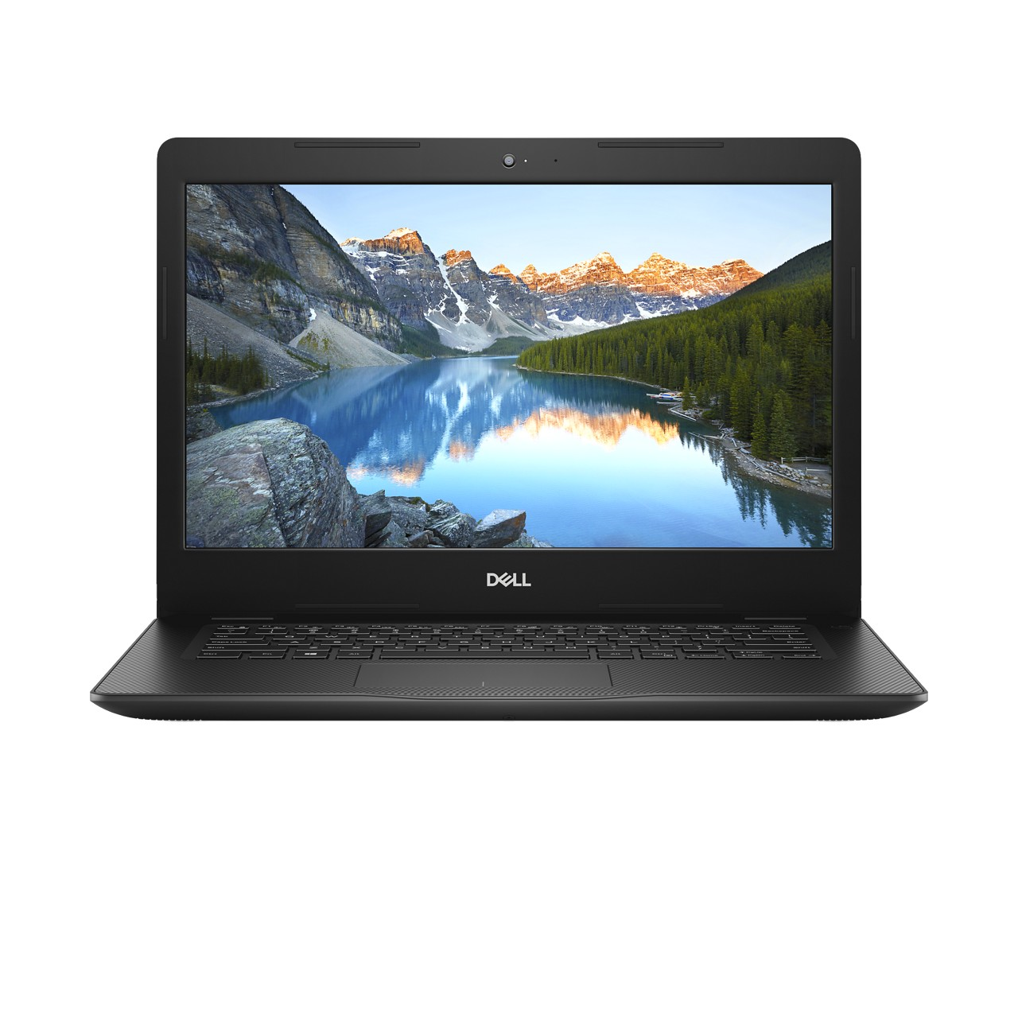
Inspiron 14 3000 (3480, 3481, 3482) Product Gallery – Dimensions/Front View
Width: 339.0 mm / 13.35”
Height : 241.9 mm / 9.52”
Thickness:
19.9 – 21.0 mm / 0.78” – 0.83”
Product appearance may vary slightly from image shown.
Some features and color subject to regional availability.

Slide 21
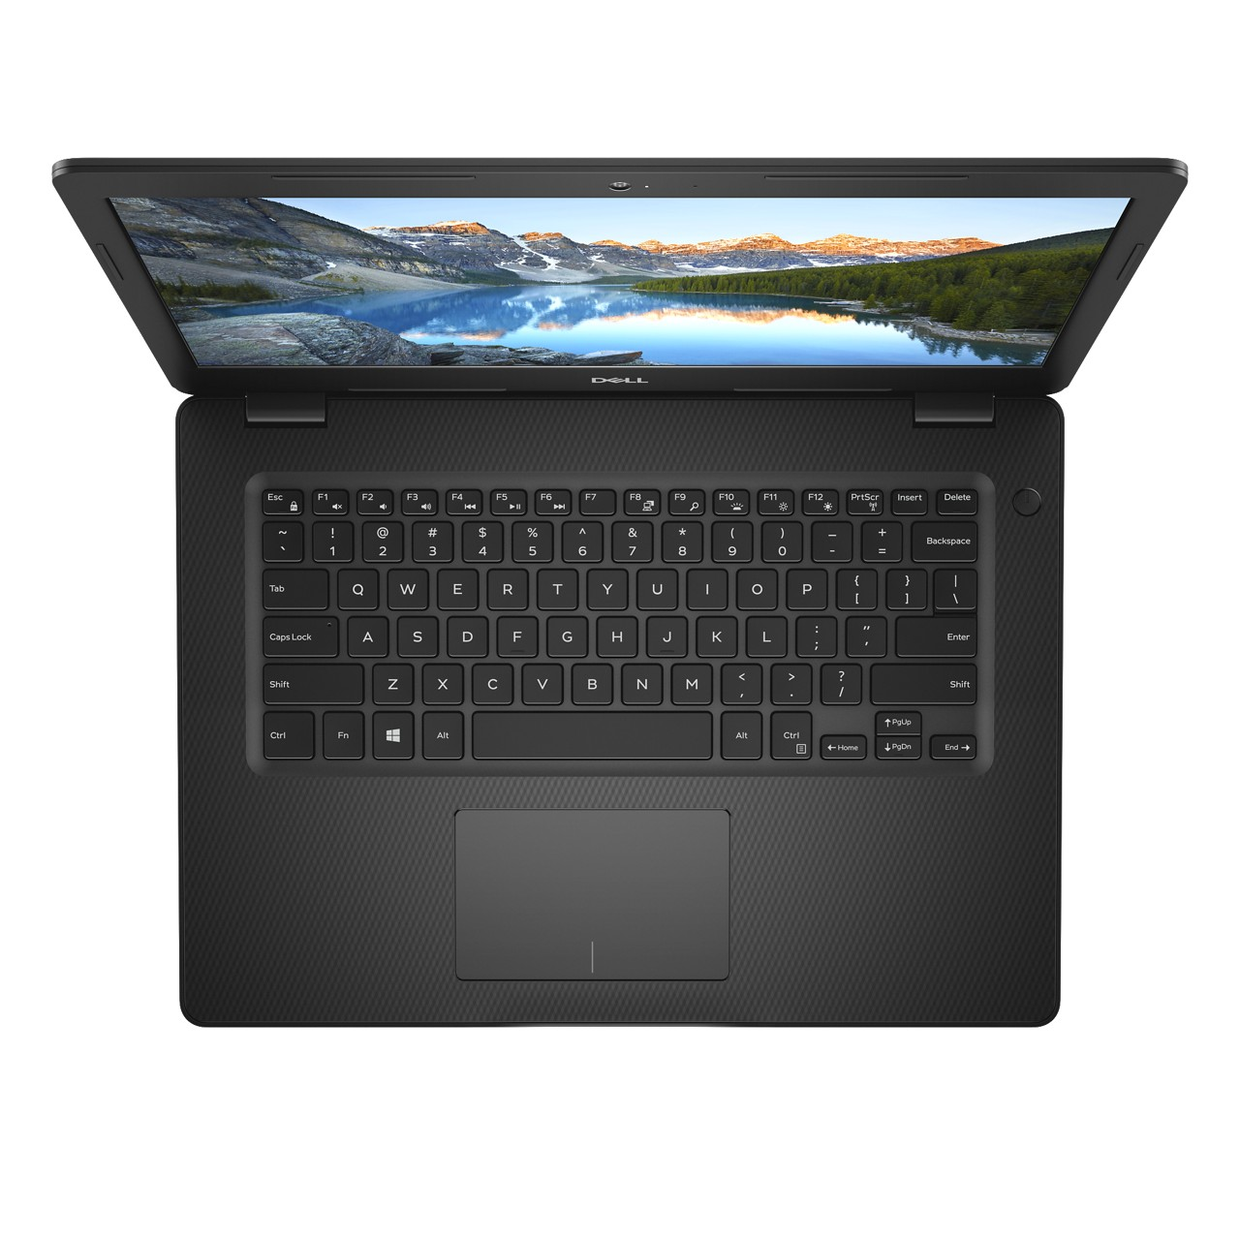
Inspiron 14 3000 (3480, 3481, 3482) Product Gallery – Top View
Power button & optional fingerprint reader
Optional backlit keyboard
Precision touchpad
Product appearance may vary slightly from image shown.
Some features and color subject to regional availability.

Slide 22
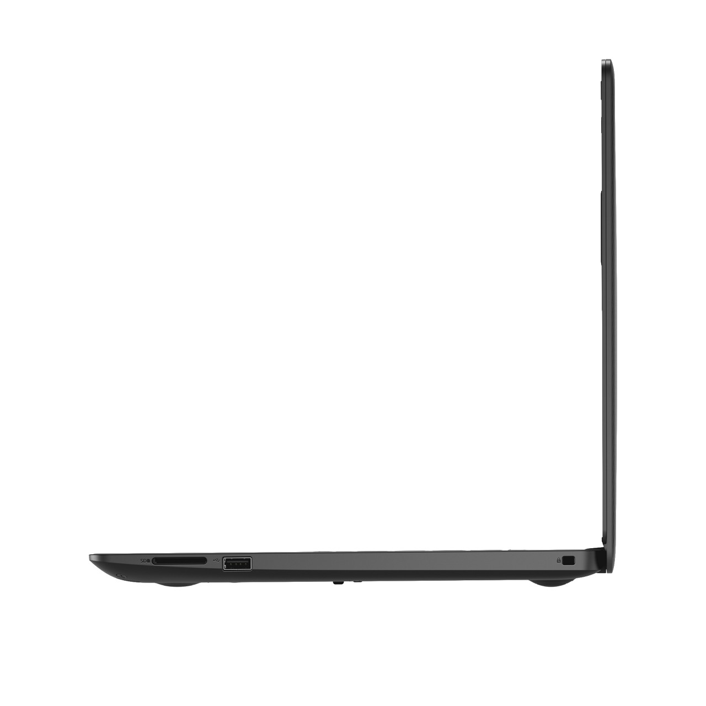
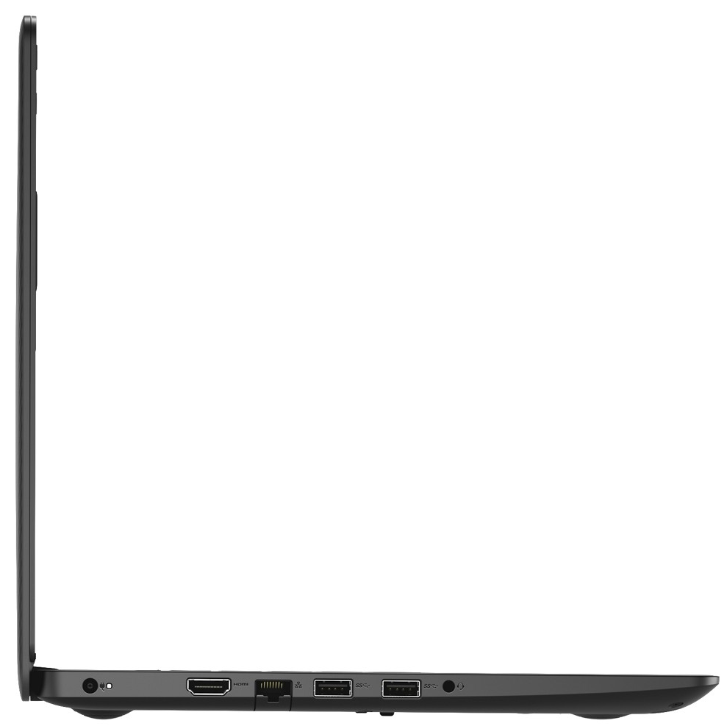
Inspiron 14 3000 (3480, 3481) Product Gallery – Side View
USB 3.1 Gen 1
SD Card Reader
USB 2.0
RJ45
HDMI 1.4b
Wedge-shaped lock slot
RJ45
SD card slot
Power
Headphone & microphone audio jack
Product appearance may vary slightly from image shown.
Some features and color subject to regional availability.

Slide 23
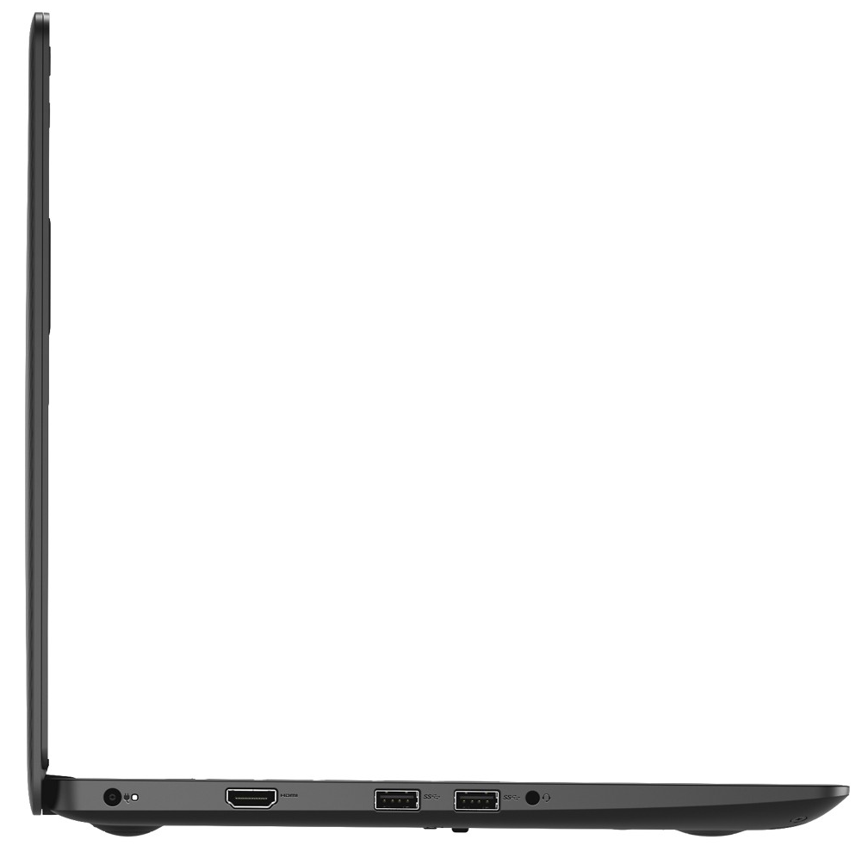
Inspiron 14 3000 (3482) Product Gallery – Side View
Power
USB 3.1 Gen 1
USB 2.0
Wedge-shaped lock slot
HDMI 1.4b
SD card slot
Headphone & microphone audio jack
Product appearance may vary slightly from image shown.
Some features and color subject to regional availability.

Slide 24
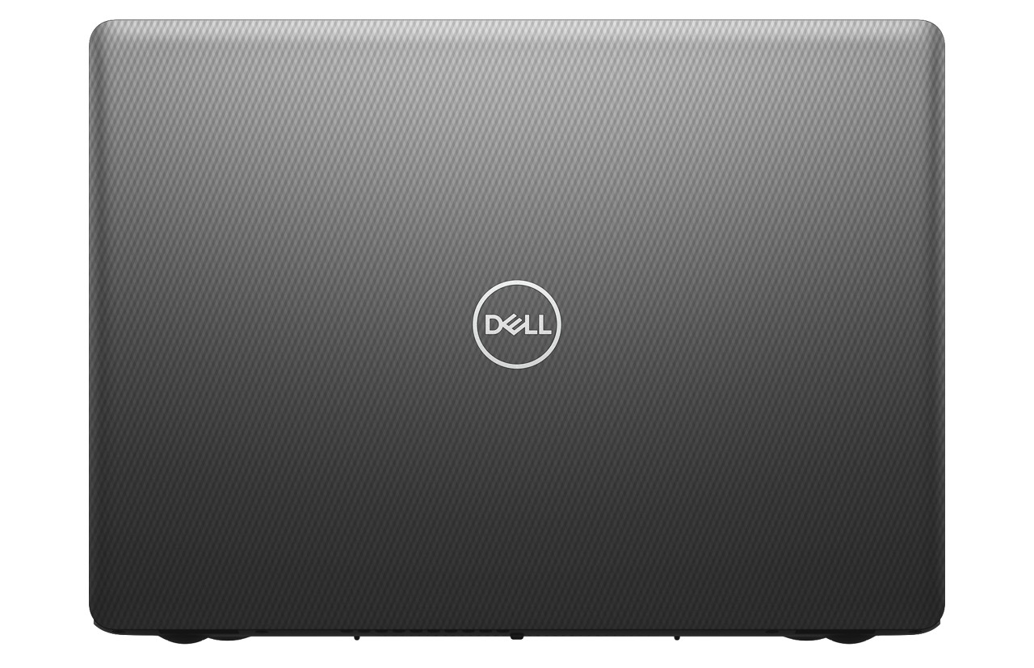
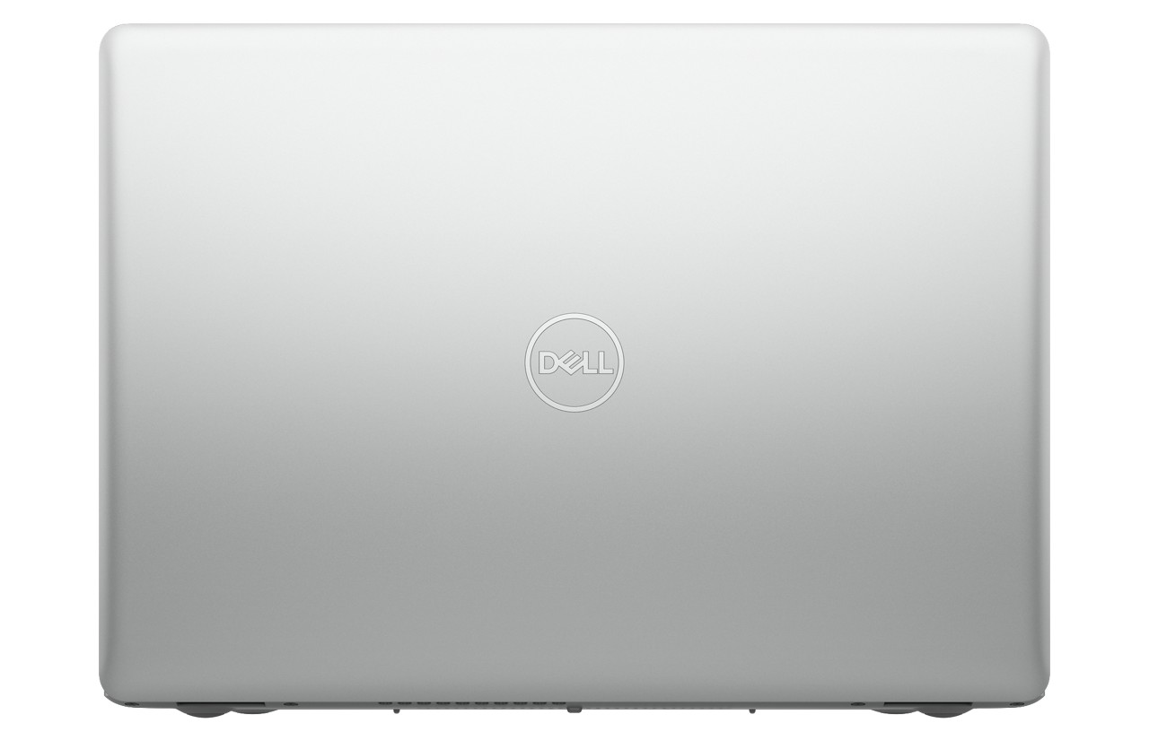
Inspiron 14 3000 (3480, 3481, 3482) Product Gallery – Color Options/Rear View
Black
Platinum Silver
Color options and availability vary by region.
Product appearance may vary slightly from image shown.
Some features and color subject to regional availability.

Slide 25
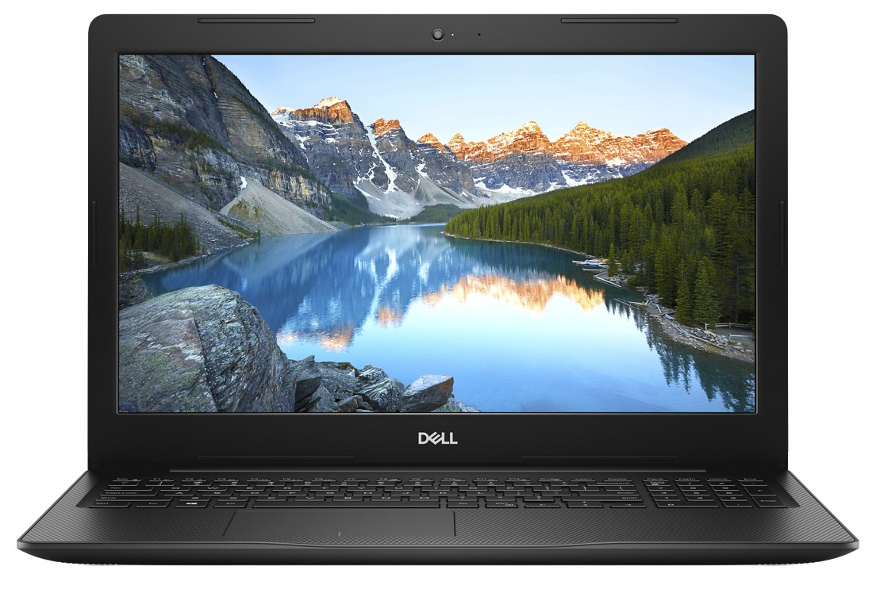
Inspiron 15 3000 (3580/3581/3582/3583/3584) Product Gallery – Dimensions/Front View
Width: 380.0 mm / 14.96”
Height : 258.0 mm / 10.16”
Thickness:
3582, 3583, 3584 & 3585: 19.9 mm / 0.78” (Without ODD)
3580, 3581, 3582 & 3585: 22.7 mm / 0.89” (With ODD)
Product appearance may vary slightly from image shown.
Some features and color subject to regional availability.

Slide 26
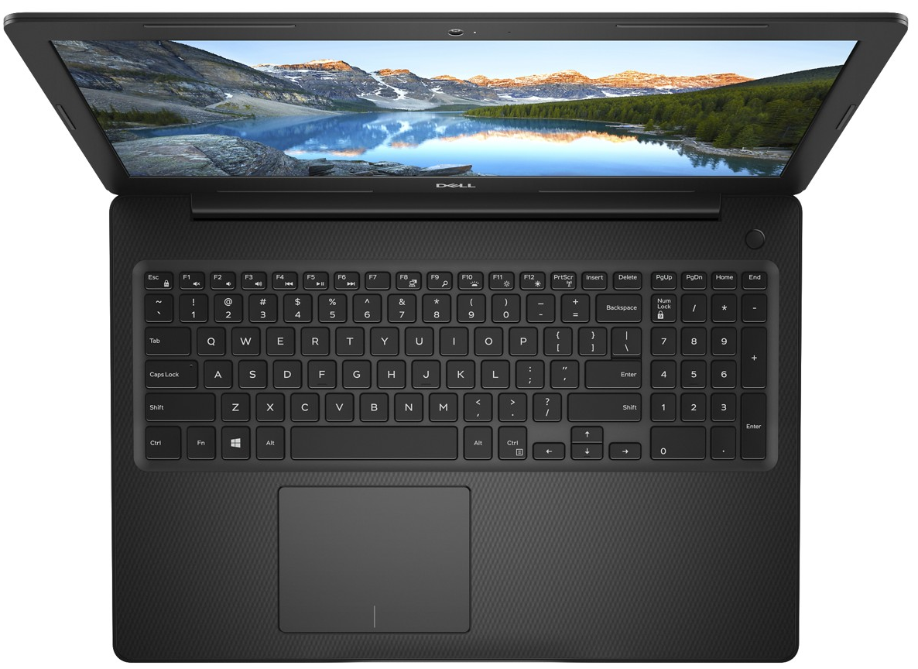
Inspiron 15 3000 (3580/3581/3582/3583/3584) Product Gallery – Top View
Optional Backlit keyboard
Power button with optional fingerprint reader
Numeric keypad
Precision touchpad
Product appearance may vary slightly from image shown.
Some features and color subject to regional availability.

Slide 27
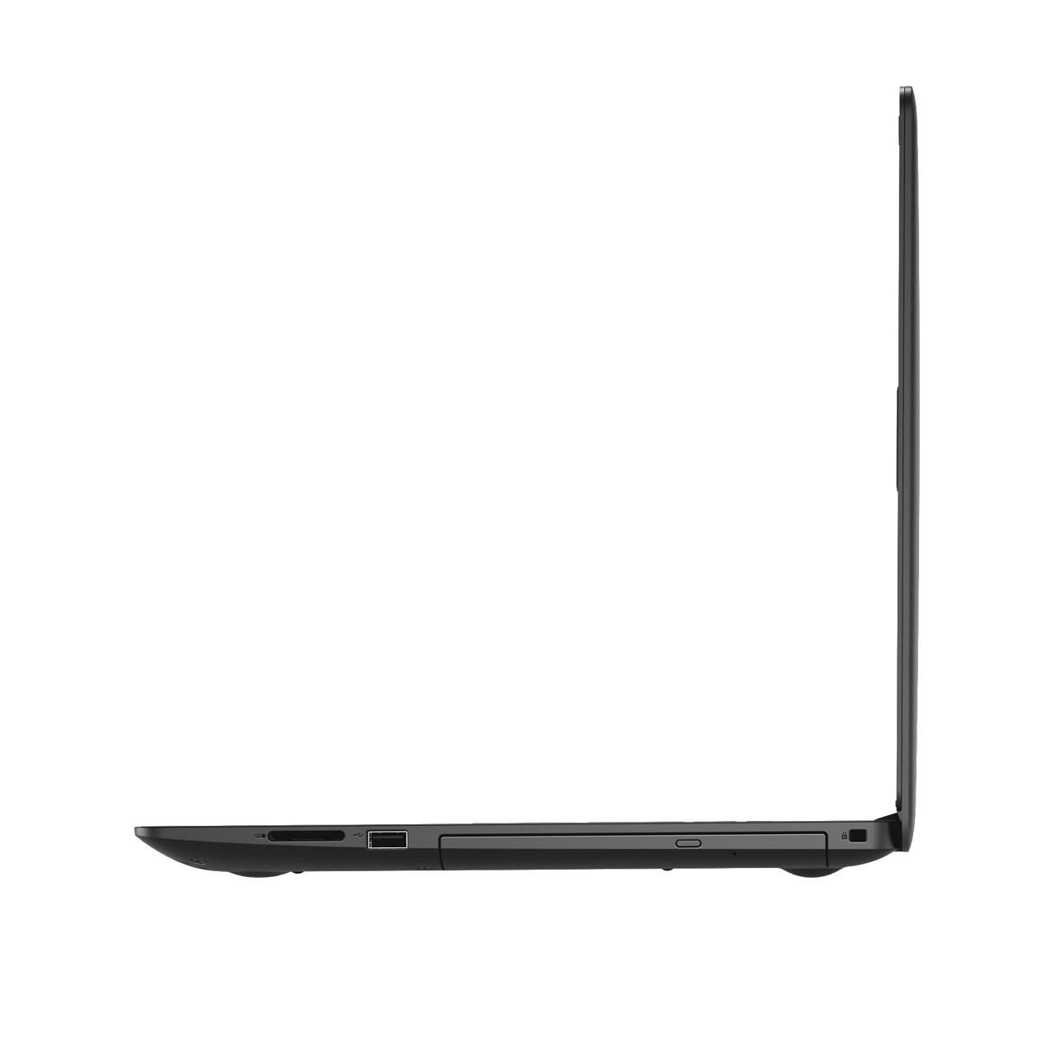
Inspiron 15 3000 (3580, 3581) Product Gallery – Side View
USB 3.1 Gen 1
SD card slot
Optical drive
HDMI 1.4b
Wedge-shaped lock slot
RJ45
USB 2.0
Power
Headphone & microphone audio jack
Product appearance may vary slightly from image shown.
Some features and color subject to regional availability.

Slide 28
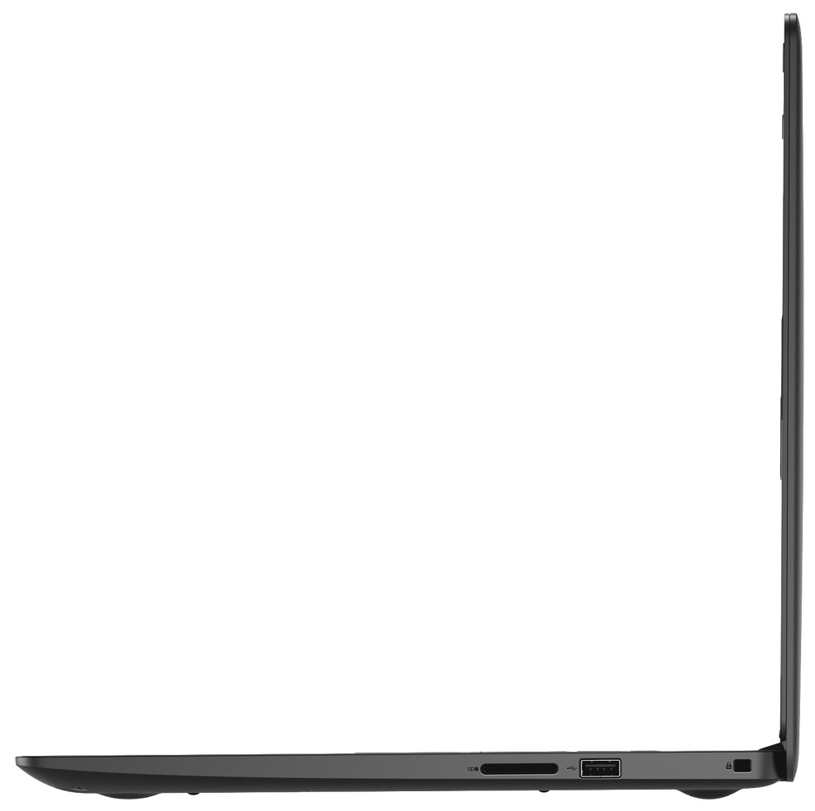
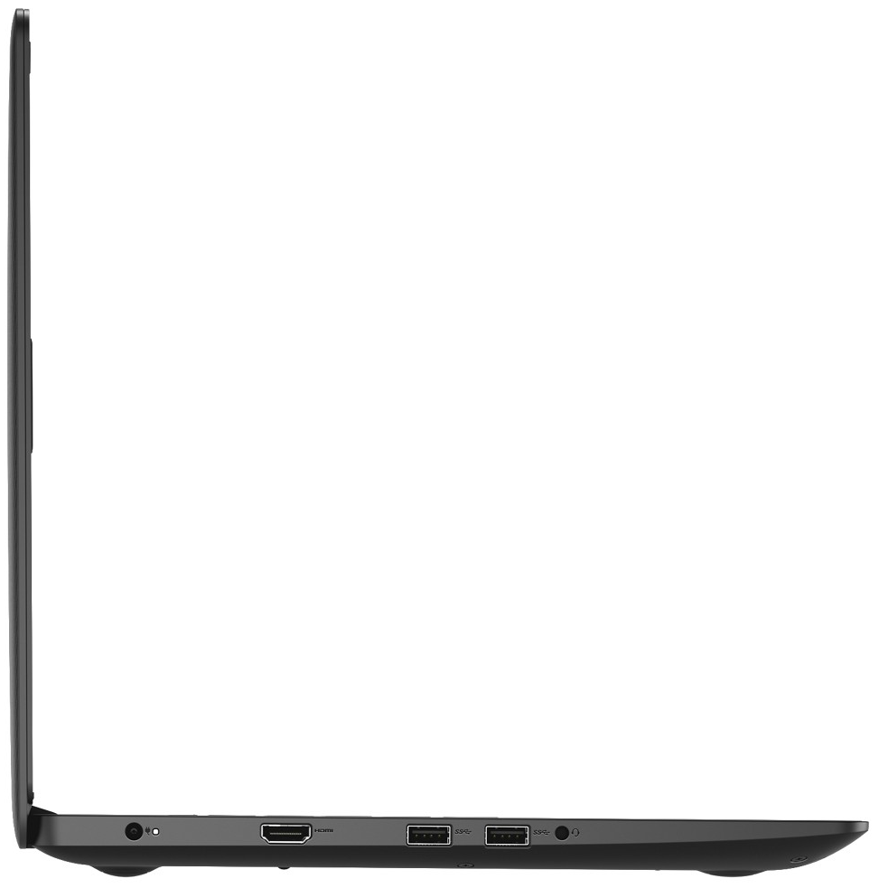
Inspiron 15 3000 (3582) Product Gallery – Side View
SD card slot
Wedge-shaped lock slot
USB 2.0
Power
USB 3.1 Gen 1
Headphone & microphone audio jack
HDMI 1.4b
Optical drive
Wedge-shaped lock slot
SD card slot
USB 2.0
Product appearance may vary slightly from image shown.
Some features and color subject to regional availability.

Slide 29
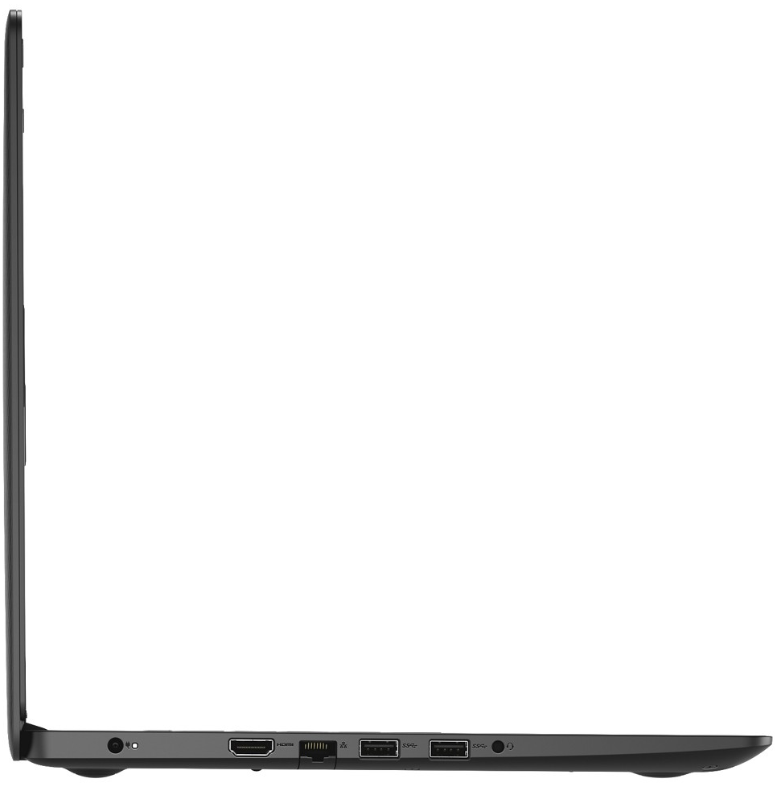
Inspiron 15 3000 (3583, 3584) Product Gallery – Side View
USB 3.1 Gen 1
USB 2.0
HDMI 1.4b
Wedge-shaped lock slot
RJ45
SD card slot
Power
Headphone & microphone audio jack
Product appearance may vary slightly from image shown.
Some features and color subject to regional availability.

Slide 30
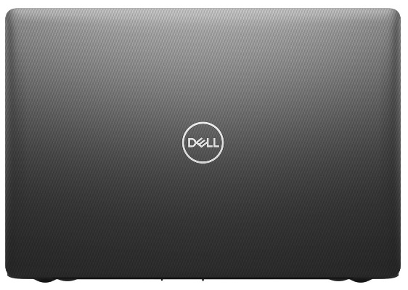
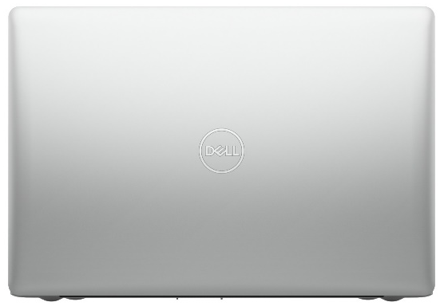
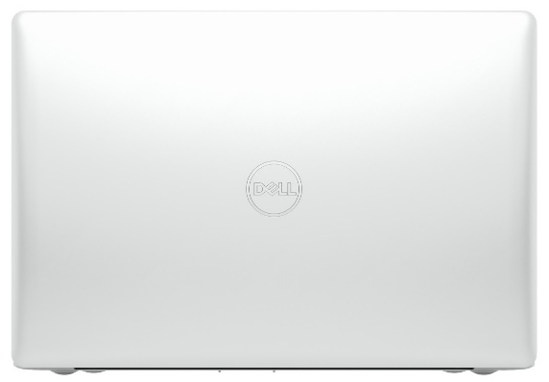
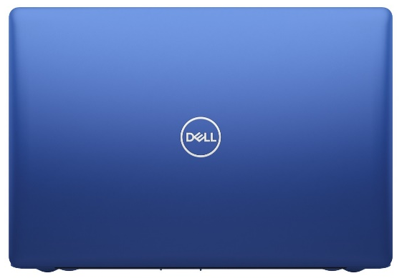
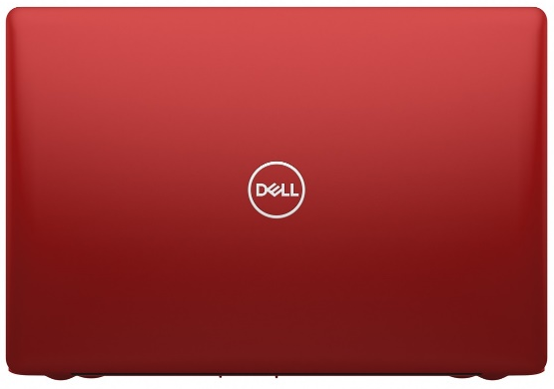
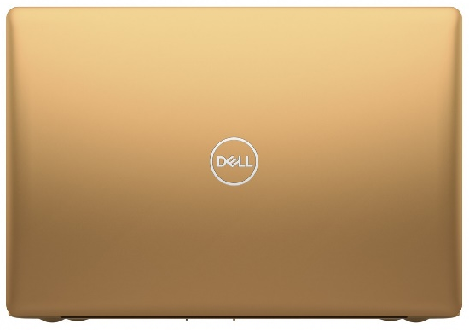
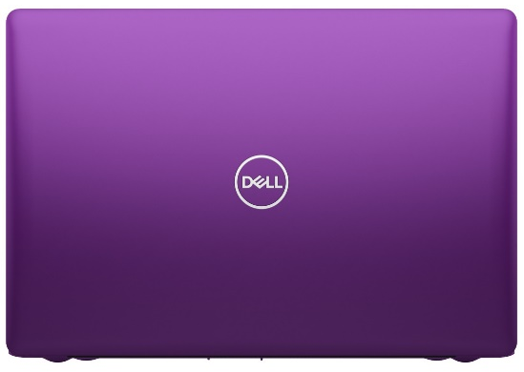
Inspiron 15 3000 (3580/3581/3582/3583/3584) Product Gallery – Color Options/Rear View
Black
Platinum Silver
Sparkling White
Ultra Blue
Beijing Red
Copper
Orchid Bloom
Color options and availability vary by region.
Product appearance may vary slightly from image shown.
Some features and color subject to regional availability.

Slide 31
Inspiron 17 3000 (3780, 3781, 3782) Product Gallery – Dimensions/Front View
Width: 415.4 mm / 16.35”
Height : 279.2 mm / 10.99”
Thickness:
25.0 mm / 0.98”
Product appearance may vary slightly from image shown.
Some features and color subject to regional availability.

Slide 32
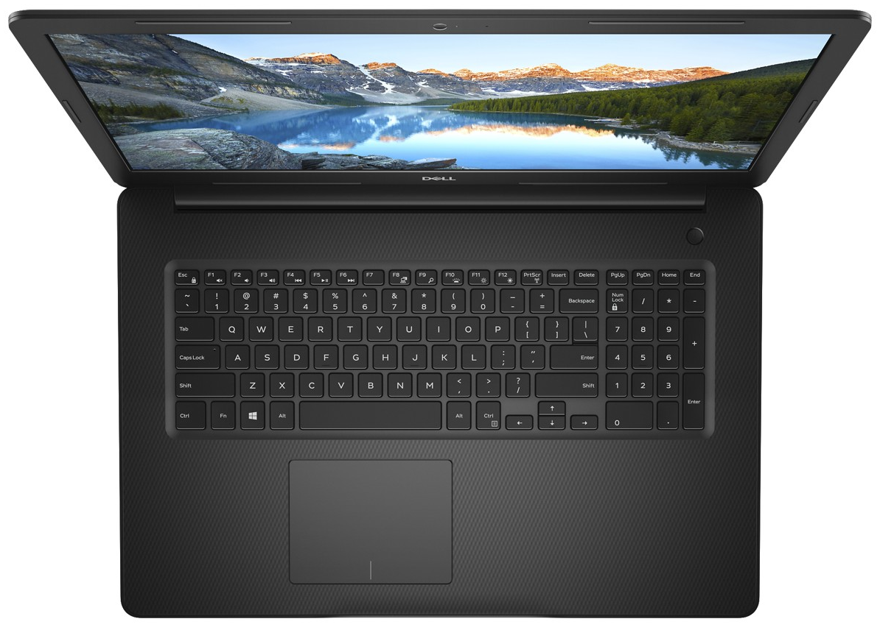
Inspiron 17 3000 (3780, 3781, 3782) Product Gallery – Top View
Power button with optional Fingerprint Reader
Optional Backlit keyboard
Numeric keypad
Precision touchpad
Product appearance may vary slightly from image shown.
Some features and color subject to regional availability.

Slide 33
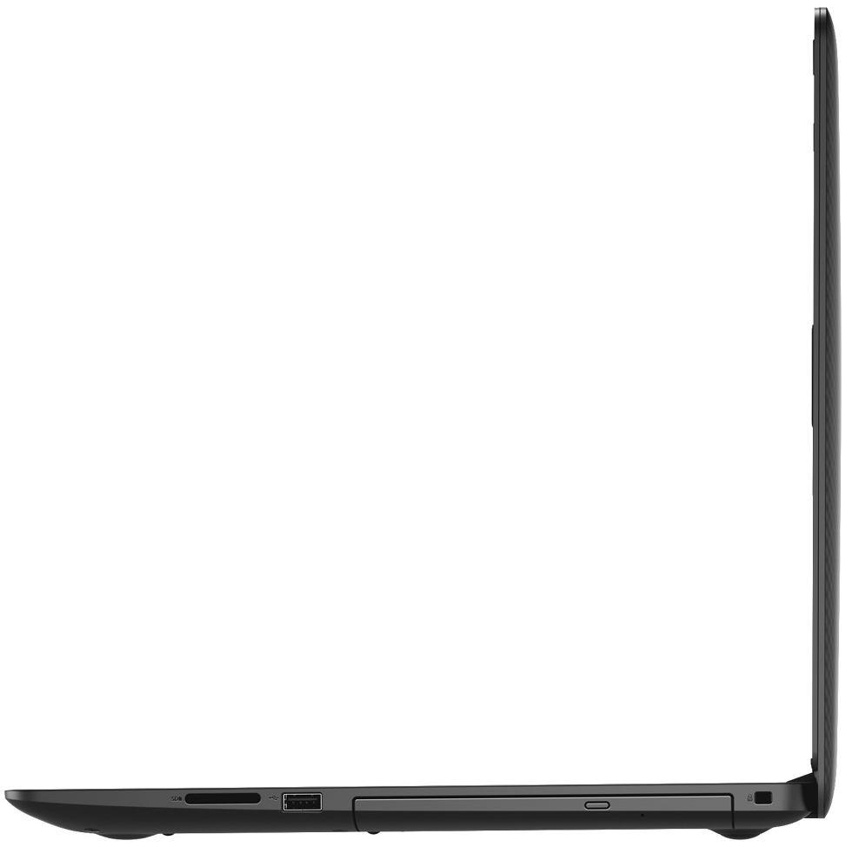
Inspiron 17 3000 (3780, 3781) Product Gallery – Side View
USB 3.1 Gen 1
SD card slot
Optical drive
HDMI 1.4b
Wedge-shaped lock slot
RJ45
USB 2.0
Power
Headphone & microphone audio jack
Product appearance may vary slightly from image shown.
Some features and color subject to regional availability.

Slide 34
Inspiron 17 3000 (3782) Product Gallery – Side View
USB 3.1 Gen 1
Power
SD card slot
Optical drive
Wedge-shaped lock slot
HDMI 1.4b
USB 2.0
Headphone & microphone audio jack
Product appearance may vary slightly from image shown.
Some features and color subject to regional availability.

Slide 35
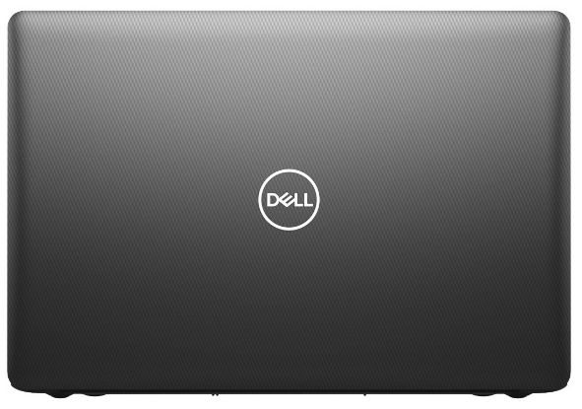
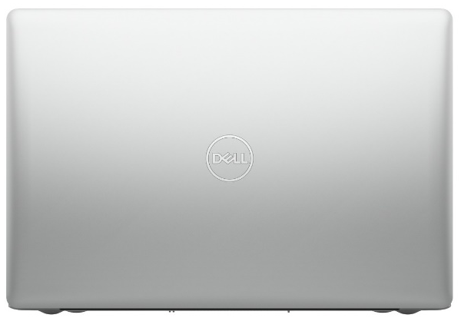
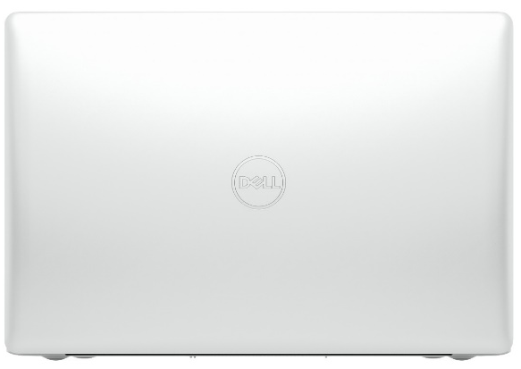
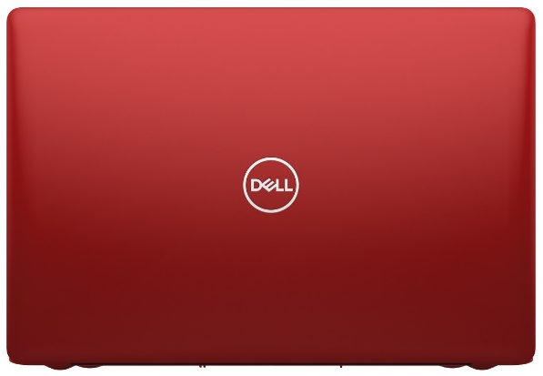
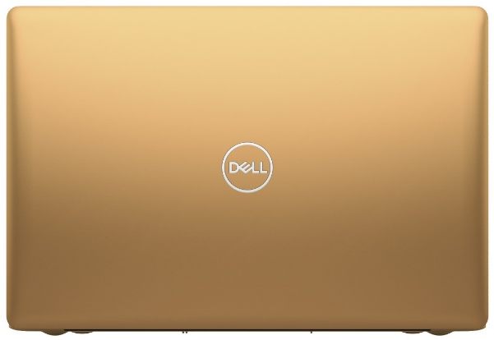
Inspiron 17 3000 (3780, 3781, 3782) Product Gallery – Dimensions/Rear View
Black
Platinum Silver
Sparkling White
Ultra Blue
Beijing Red
Copper
Orchid Bloom
Color options and availability vary by region.
Product appearance may vary slightly from image shown.
Some features and color subject to regional availability.

Slide 36
Inspiron 14 3000 Battery Life Claims
Pending Legal Review
* The stated Watt Hour (WHr) is not an indication of battery life.
** Battery life is based on Mobile Mark 2014 benchmark test, available at http://www.bapco.com. Test results are for comparative purposes only. Actual battery life may be significantly less than the test results and varies depending on product configuration and use, software, usage, operating conditions, power management settings and other factors. Maximum battery life will decrease with time.

Slide 37
Inspiron 15 3000 Battery Life Claims
Pending Legal Review
* The stated Watt Hour (WHr) is not an indication of battery life.
** Battery life is based on Mobile Mark 2014 benchmark test, available at http://www.bapco.com. Test results are for comparative purposes only. Actual battery life may be significantly less than the test results and varies depending on product configuration and use, software, usage, operating conditions, power management settings and other factors. Maximum battery life will decrease with time.

Slide 38
Inspiron 17 3000 Battery Life Claims
Pending Legal Review
* The stated Watt Hour (WHr) is not an indication of battery life.
** Battery life is based on Mobile Mark 2014 benchmark test, available at http://www.bapco.com. Test results are for comparative purposes only. Actual battery life may be significantly less than the test results and varies depending on product configuration and use, software, usage, operating conditions, power management settings and other factors. Maximum battery life will decrease with time.

Slide 39
Inspiron 14, 15, 17 3000 Weight Claims
Pending Legal Review
* Weights vary depending on configuration and manufacturing variability..

Slide 40
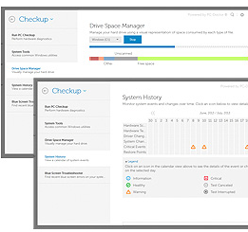
Inspiron software
Microsoft Office 2016 Trial
Fully loaded with the latest and greatest versions of favorite applications: Word, Excel, PowerPoint, and OneNote.
McAfee LiveSafe
Award-winning security for every device; shields PCs from viruses and online threats like risky websites and dangerous downloads, shreds digital files like e-bills and online bank statements saved on PCs.
Foxit Phantom Standard PDF
Converts PDFs to Word, Excel or PowerPoint formats while preserving fonts, formatting, and layouts; access and share recently viewed PDFs from computers or mobile devices.
SupportAssist
A Windows based software program that automates support from Dell by identifying hardware and software issues on Dell laptops, desktops and tablets. SupportAssist notifies customers when an issue is detected.
Dell Mobile Connect
Allows complete wireless integration between your Dell PC and smartphone. Make calls, send texts, get notifications and even mirror your phone onto your PC to interact with apps
Dell Color Profiles
Enhances on-screen content by adjusting perceived color characteristics and assigning color filters based on preference
SmartByte
Experience less buffering, few drops, and better resolution with this network optimizer. It detects, prioritizes, and delivers your video packets ahead of other network traffic, so streaming video and web calls run smoothly.
Waves MaxxAudio® Pro
Professional-grade control panel providing audio controls and tuning that adds dimensionality to music and videos.
*See page 15 for important information

Slide 41
Services for Inspiron
Dell has services to help with technology needs throughout the life of your Inspiron. Our mission is to be the technology services provider you trust to keep you connected and productive so you can focus on doing more.
Basic Limited Hardware Warranty Plus Mail-In Service after Remote Diagnosis
Dell’s 1 Year Limited Hardware Warranty with Mail-In service after remote diagnosis¹ – If your system encounters an issue covered by Dell’s Limited Hardware Warranty² and that issue cannot be resolved remotely, this service offers a Mail-In Repair Service (customer provides box and Dell pays shipping) for defects in materials and workmanship in your PC. You can also upgrade or extend your warranty and support coverage with Dell Premium Support. With Premium Support you get 24x7 access to dedicated Dell tech support experts and up to 86% less time on the phone than Limited Hardware Warranty.³
Dell Premium Support
Tech support can be frustrating with long phone menus, hold times and being transferred again and again. Now, Dell Premium Support, eliminates the hassle with SupportAssist technology by automatically detecting hardware and software issues and proactively alerting you with system alerts and by email when they occur. Our expert technicians even call you with all the information they need to quickly resolve critical issues. You also get 24x7 phone access to experts and onsite support after remote diagnosis¹.
Dell Premium Support Plus⁴
Premium Support Plus for PCs is the best supply plan for your busy lifestyle. Everything you need is included - from easy 24/7 access to experts, to accident repairs, and technicians that come to you.
It keeps your computer running at its best. When used with Dell’s exclusive SupportAssist technology1, it automatically predicts problems before they happen, optimizes PC settings and removes viruses. If there is an issue, work begins without you having to pick up the phone, and that means a faster fix.
Premium Support Plus is the ultimate support experience, designed for you.
Accidental Damage Service⁵
Accidents happen – Dell can help. Minimize the unplanned expenses and downtime by protecting you against unforeseen mishaps caused by drops, spills, surges and breaks. No matter how careful you are, accidents can happen. Accidental Damage Service can provide repair or replacement of your system for accidents up to 3 years, not otherwise covered by the Limited Hardware Warranty.²
1 - Onsite Service is not available on Chromebook or Venue tablets, except the Venue 11 Pro. Remote Diagnosis is determination by online/phone technician of cause of issue; may involve customer access to inside of system and multiple or extended sessions. If issue is covered by Limited Hardware Warranty and not resolved remotely, technician and/or part will be dispatched, usually in 1 or 2 business days following completion of Remote Diagnosis. Onsite Service is provided by Dell Marketing L.P. Availability varies. Other conditions apply. For complete details about Onsite Service, see dell.com/ servicecontracts
2 - For copy of Limited Hardware Warranty, write Dell USA LP, Attn: Warranties, One Dell Way, Round Rock, TX 78682.
3 - Based on May 2015 Principled Technologies Test Report commissioned by Dell comparing Premium Support with Ltd. Hardware Warranty tech support troubleshooting for hard drive failure. Actual results will vary. Click here for full report.
4 - SupportAssist: SupportAssist not available on Linux, Windows RT, Android, Ubuntu or Chrome based products. SupportAssist automatically detects and proactively alerts Dell to: operating system issues, software upgrades, driver updates and patches, failures of hard drives, batteries. Predictive analysis failure detection is limited to hard drives, solid state drives and batteries.
5 - This service excludes theft, loss, and damage due to fire, flood or other acts of nature, or intentional damage. Customers may be required to return unit to Dell. Limit of 1 qualified incident per contract year. For complete details, visit www.dell.com/servicecontracts.

Slide 42
Important information
Hard Drives: GB means 1 billion bytes and TB equals 1 trillion bytes; actual capacity varies with preloaded material and operating environment and will be less.
Graphics & shared memory: GB means 1 billion bytes and TB equals 1 trillion bytes; significant system memory may be used to support graphics, depending on system memory size and other factors.
Wireless connectivity: Where wireless access is available. Additional access charges apply in some locations.
Weight: Weights vary depending on configuration and manufacturing variability.
Limited hardware warranty: For copy of Ltd Hardware Warranty, write Dell USA LP, Attn: Warranties, One Dell Way, Round Rock, TX 78682 or see www.dell.com/warranty.
Dell ProSupport™: Availability and terms of Dell Services vary by region. For more information, visit www.dell.com/servicedescriptions.
Accidental Damage: Service excludes theft, loss, and damage due to fire, flood or other acts of nature, or intentional
damage. Customer may be required to return unit to Dell. For complete details, visit www.dell.com/servicecontracts.
Return for Repair after Remote Diagnosis: Remote Diagnosis is determination by online/phone technician of cause of issue; may involve customer access to inside of system and multiple or extended sessions. If issue is covered by Limited Hardware and not resolved remotely, this service offers a 10-14 day mail-in repair option following completion of Remote Diagnosis
Rapid Return for Repair after Remote Diagnosis: Remote Diagnosis is determination by online/phone technician of cause of issue and multiple or extended sessions. If issue is covered by Limited Hardware Warranty
(www.dell.com/warranty) and not resolved remotely, shipping instructions will be provided. Next Business Day shipping not available in all areas, which may delay repair and return times. Other conditions apply. For complete details about Rapid Return service, visit www.dell.com/servicecontracts
*EPEAT registration varies by country. Please see www.epeat.net for specific country registration and rating.
CAUTION: GEOGRAPHIC LIMITATIONS ON COMPARATIVE ADVERTISING
Comparative claims are not allowed in all countries. Please see below to learn which countries ban Dell vs. Dell claims, and which countries will allow the claims only if based upon independent third party testing. You may also contact Legal Counsel in the Region where the claim will be made for additional guidance.
3rd party testing required (Do not make claims) in: South Africa, Ukraine, Venezuela.
Copyright 2018 Dell Inc. All rights reserved. Intel and Core are trademarks or registered trademarks of Intel Corporation or its subsidiaries in the United States of America and other countries. Microsoft, Windows, and Windows 10 are registered trademarks of Microsoft Corporation. Other trademarks or trade names may be used in this document to refer to either the entities claiming the marks and names or their products. Dell disclaims proprietary interest in the marks and names of others. Reproduction in any manner whatsoever without express written permission from Dell Inc. is strictly forbidden.

